Slide 1

Quantum Computing
5. Quantum Circuits
Quantum Computing Insitute
https://qcict.org
Prof. Aleksandar Radovanovic
alex@qcict.org

Slide 2
Connecting
Quantum Gates

Slide 3
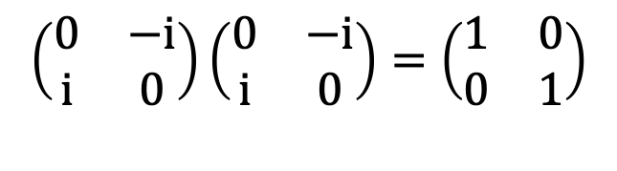
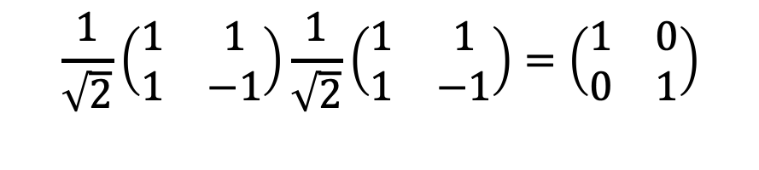
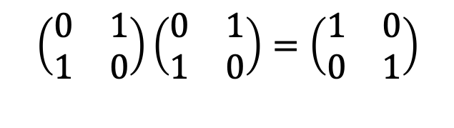

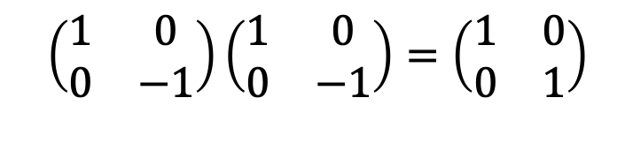

Reducing Circuits to NOP / Hermitian gates
X
X
I
+
+
$$≡$$
I
$$\left(\begin{matrix}\text{0} & \text{1} \\ \text{1} & 0\end{matrix}\right)\left(\begin{matrix}\text{0} & \text{1} \\ \text{1} & 0\end{matrix}\right)=\left(\begin{matrix}\text{1} & \text{0} \\ \text{0} & \text{1}\end{matrix}\right)$$
Y
Y
I
Y
Y
$$≡$$
I
$$\left(\begin{matrix}\text{0} & −i \\ \text{i} & 0\end{matrix}\right)\left(\begin{matrix}\text{0} & −i \\ \text{i} & 0\end{matrix}\right)=\left(\begin{matrix}\text{1} & \text{0} \\ \text{0} & \text{1}\end{matrix}\right)$$
Z
Z
I
Z
Z
$$≡$$
I
$$\left(\begin{matrix}\text{1} & \text{0} \\ \text{0} & \text{−1}\end{matrix}\right)\left(\begin{matrix}\text{1} & \text{0} \\ \text{0} & \text{−1}\end{matrix}\right)=\left(\begin{matrix}\text{1} & \text{0} \\ \text{0} & \text{1}\end{matrix}\right)$$
I
H
H
I
H
H
$$≡$$
I
$$\frac{\text{1}}{\sqrt{\text{2}}}\left(\begin{matrix}\text{1} & \text{1} \\ \text{1} & \text{−1}\end{matrix}\right)\frac{\text{1}}{\sqrt{\text{2}}}\left(\begin{matrix}\text{1} & \text{1} \\ \text{1} & \text{−1}\end{matrix}\right)=\left(\begin{matrix}\text{1} & \text{0} \\ \text{0} & \text{1}\end{matrix}\right)$$
Notes:
By identifying pairs of gates that cancel each other, we can simplify quantum circuits, sometimes reducing entire sections to a No-Operation (NOP).
Pauli gates and the Hadamard gate are Hermitian, which means that applying any of them twice is equivalent to the identity. In other words, two in a row cancel out, so they can be removed from the circuit.
Mathematically, this is clear because multiplying the operator by itself gives the identity matrix. A simple way to understand it is that applying a Hadamard once places a qubit into superposition, and applying it a second time returns the qubit to its original state.

Slide 4

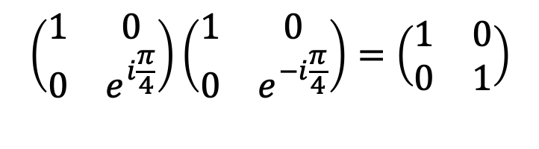

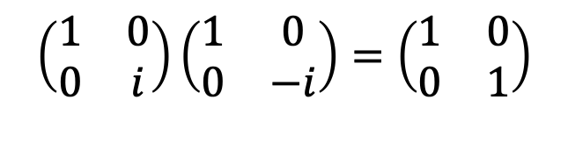
Reducing Circuits to NOP / non-Hermitian Gates
S
S†
I
S
S†
$$≡$$
I
$$\left(\begin{matrix}1 & \text{0} \\ \text{0} & i\end{matrix}\right)\left(\begin{matrix}\text{1} & \text{0} \\ \text{0} & −i\end{matrix}\right)=\left(\begin{matrix}\text{1} & \text{0} \\ \text{0} & \text{1}\end{matrix}\right)$$
T
T†
I
T
T†
$$≡$$
I
$$\left(\begin{matrix}1 & 0 \\ 0 & e^{i\frac{π}{4}}\end{matrix}\right)\left(\begin{matrix}1 & 0 \\ 0 & e^{−i\frac{π}{4}}\end{matrix}\right)=\left(\begin{matrix}\text{1} & \text{0} \\ \text{0} & \text{1}\end{matrix}\right)$$
T
H
H
T†
$$≡$$
I
Notes:
In addition to Hermitian gates, there are also unitary gates that are not Hermitian. These gates are still reversible, but their inverses are different gates.
For example, the S gate has its inverse S†. When applied together, S S†=I which is equivalent to a NOP.
Similarly, the T gate and its inverse T† cancel each other out, since T T†=I.
In the third example, two H gates cancel each other out, simplifying the circuit to T T†. Since T T†=I, this reduces further to the identity. In the end, the entire circuit is equivalent to doing nothing. This means that whenever a gate and its adjoint appear in a circuit, even if they are not consecutive, they can be combined and simplified away.

Slide 5
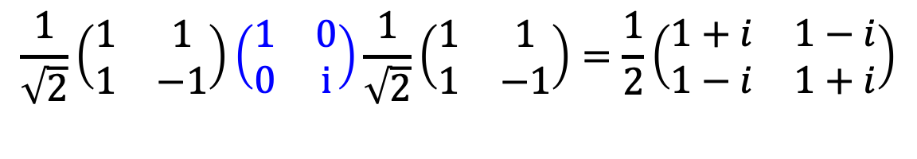
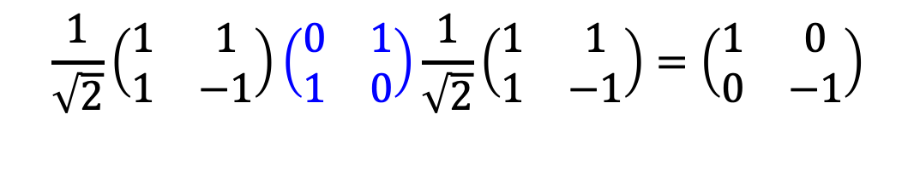

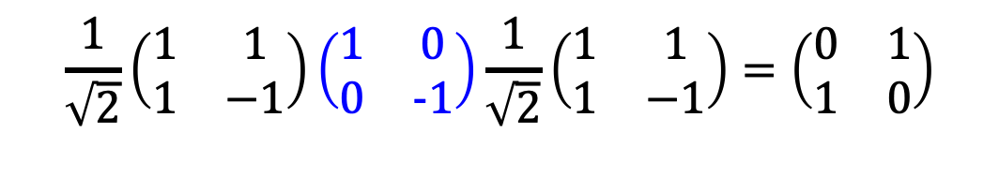


Simplifying Gate Sequences
H
X
H
Z
H
+
H
$$≡$$
Z
$$\frac{\text{1}}{\sqrt{\text{2}}}\left(\begin{matrix}\text{1} & \text{1} \\ \text{1} & \text{−1}\end{matrix}\right)\left(\begin{matrix}\text{0} & \text{1} \\ \text{1} & \text{0}\end{matrix}\right)\frac{\text{1}}{\sqrt{\text{2}}}\left(\begin{matrix}\text{1} & \text{1} \\ \text{1} & \text{−1}\end{matrix}\right)=\left(\begin{matrix}\text{1} & \text{0} \\ \text{0} & \text{−1}\end{matrix}\right)$$
H
Z
H
X
H
Z
H
$$≡$$
+
$$\frac{\text{1}}{\sqrt{\text{2}}}\left(\begin{matrix}\text{1} & \text{1} \\ \text{1} & \text{−1}\end{matrix}\right)\left(\begin{matrix}\text{1} & \text{0} \\ 0 & \text{−1}\end{matrix}\right)\frac{\text{1}}{\sqrt{\text{2}}}\left(\begin{matrix}\text{1} & \text{1} \\ \text{1} & \text{−1}\end{matrix}\right)=\left(\begin{matrix}\text{0} & \text{1} \\ \text{1} & 0\end{matrix}\right)$$
H
S
H
$$\sqrt{X}$$
$$\sqrt{X}$$
$$\frac{\text{1}}{\sqrt{\text{2}}}\left(\begin{matrix}\text{1} & \text{1} \\ \text{1} & \text{−1}\end{matrix}\right)\left(\begin{matrix}1 & 0 \\ 0 & \text{i}\end{matrix}\right)\frac{\text{1}}{\sqrt{\text{2}}}\left(\begin{matrix}\text{1} & \text{1} \\ \text{1} & \text{−1}\end{matrix}\right)=\frac{\text{1}}{2}\left(\begin{matrix}1+i & 1−i \\ 1−i & 1+i\end{matrix}\right)$$
H
S
H
$$≡$$
Notes:
A sequence of single-qubit gates can often be simplified. Instead of treating every gate in the sequence as a separate operation, we can use algebraic rules and matrix identities to reduce them. This means that several gates in a row may combine into a single gate, or even cancel out completely. Recognizing these patterns is an important part of circuit optimization because it shortens the circuit and reduces the number of operations applied to a qubit.
For example, the sequence HXH is equivalent to the Pauli-Z gate. This can be directly verified by matrix multiplication.
The sequence HZH is equivalent to the Pauli-XX gate.
Another example is the sequence HS H. This is equivalent to the square-root of X gate

Slide 6



Combining Simplification and Cancellation
H
+
H
Z
$$≡$$
Z
Z
$$≡$$
I
H
S
H
$${\sqrt{X}}^{†}$$
$$≡$$
$$\sqrt{X}$$
$${\sqrt{X}}^{†}$$
$$≡$$
I
Notes:
By combining simplification and cancellation, we can reduce the number of gates even in cases where this is not immediately obvious.
For example, in the sequence HXHZ, the HXH simplifies to Z. With another Z after it, we get ZZ=I, so the entire circuit is equivalent to doing nothing.
In the second example, the sequence HSH simplifies to $\sqrt{X}$. When followed by ${\sqrt{X}}^{†}$, the two cancel, again reducing the circuit to a NOP.
These examples show how recognizing hidden simplifications and cancellations can collapse seemingly complex circuits all the way down to the identity.

Slide 7

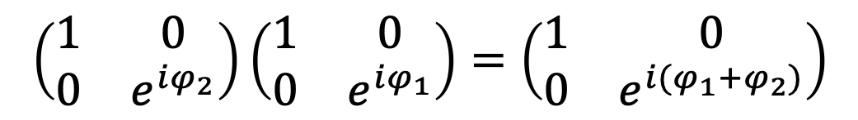

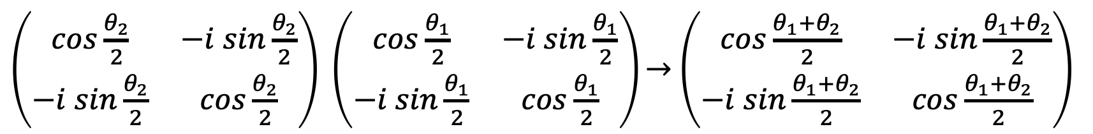
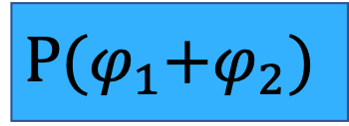

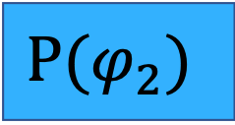

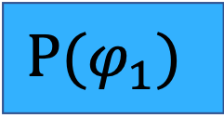

Phase and Rotation Gates: Angle Addition Rule (1)
$${P(φ}_{1})$$
$${P(φ}_{2})$$
$$≡$$
$$P{(φ}_{1}+φ_{2})$$
$$\left(\begin{matrix}1 & \text{0} \\ \text{0} & e^{iφ_{2}}\end{matrix}\right)\left(\begin{matrix}1 & \text{0} \\ \text{0} & e^{iφ_{1}}\end{matrix}\right)=\left(\begin{matrix}1 & \text{0} \\ \text{0} & e^{i{(φ}_{1}+φ_{2})}\end{matrix}\right)$$
$${Rx(θ}_{1})$$
$${Rx(θ}_{2})$$
$$≡$$
$$Rx{(θ}_{1}+θ_{2})$$
$\left(\begin{matrix}cos\frac{θ_{2}}{2} & −i sin\frac{θ_{2}}{2} \\ −i sin\frac{θ_{2}}{2} & cos\frac{θ_{2}}{2}\end{matrix}\right) \left(\begin{matrix}cos\frac{θ_{1}}{2} & −i sin\frac{θ_{1}}{2} \\ −i sin\frac{θ_{1}}{2} & cos\frac{θ_{1}}{2}\end{matrix}\right)\underset{→}{}$ $\left(\begin{matrix}cos\frac{{θ_{1}+θ}_{2}}{2} & −i sin\frac{{θ_{1}+θ}_{2}}{2} \\ −i sin\frac{{θ_{1}+θ}_{2}}{2} & cos\frac{{θ_{1}+θ}_{2}}{2}\end{matrix}\right)$
Notes:
Similarly to simplifying other gate sequences, a sequence of phase gates can be replaced by a single phase gate. The argument of this gate is equal to the sum of the individual phase angles. This can be verified by multiplying the matrices of the phase gates. The product of the phase factors gives the sum of the phase angles in the exponent.
A similar principle applies to rotations. For example, two or more Rx​ gates in sequence can be replaced by a single Rx​ gate. The argument of this gate is equal to the sum of the individual rotation angles. This can be verified by multiplying the matrices, where the trigonometric terms combine to give the expected result.

Slide 8
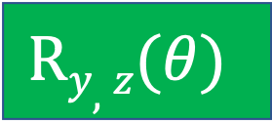

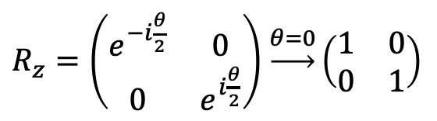
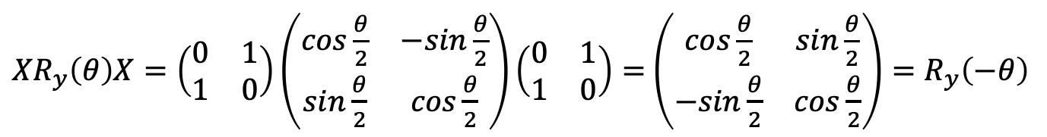
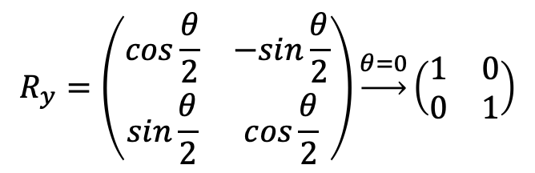

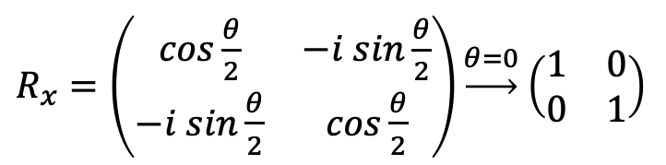

Phase and Rotation Gates: Angle Addition Rule (2)
$$R(0)$$
$$≡$$
I
$\begin{matrix}R_{x}=\left(\begin{matrix}cos\frac{θ}{2} & −i sin\frac{θ}{2} \\ −i sin\frac{θ}{2} & cos\frac{θ}{2}\end{matrix}\right)\underset{→}{θ=0}\end{matrix}$ $\left(\begin{matrix}\text{1} & \text{0} \\ \text{0} & \text{1}\end{matrix}\right)$
$$\begin{matrix}R_{y}=\left(\begin{matrix}cos\frac{θ}{2} & −sin\frac{θ}{2} \\ sin\frac{θ}{2} & cos\frac{θ}{2}\end{matrix}\right)\underset{→}{θ=0}\left(\begin{matrix}\text{1} & \text{0} \\ \text{0} & \text{1}\end{matrix}\right)\end{matrix}$$
$\begin{matrix}R_{z}=\left(\begin{matrix}e^{−i\frac{θ}{2}} & 0 \\ 0 & e^{i\frac{θ}{2}}\end{matrix}\right)\end{matrix}$ $\underset{→}{θ=0}\left(\begin{matrix}\text{1} & \text{0} \\ \text{0} & \text{1}\end{matrix}\right)$
+
+
$$Ry,z(−θ)$$
$$Ry,z(θ)$$
$$≡$$
$$≡$$
$\begin{matrix}{XR}_{y}\left(θ\right)X=\left(\begin{matrix}\text{0} & \text{1} \\ \text{1} & \text{0}\end{matrix}\right)\left(\begin{matrix}cos\frac{θ}{2} & −sin\frac{θ}{2} \\ sin\frac{θ}{2} & cos\frac{θ}{2}\end{matrix}\right)\left(\begin{matrix}\text{0} & \text{1} \\ \text{1} & \text{0}\end{matrix}\right)=\end{matrix}$ $\left(\begin{matrix}cos\frac{θ}{2} & sin\frac{θ}{2} \\ −sin\frac{θ}{2} & cos\frac{θ}{2}\end{matrix}\right)=R_{y}\left(−θ\right)$
Notes:
If the rotation angle is reduced to zero, meaning there is no rotation, the R operators reduce to the identity matrix.
In addition, if an Ry​ or Rz operator is placed between two NOT gates, the result is a rotation about the y or z with the negative of the original angle. Intuitively, the two NOT gates flip the axis of rotation, which effectively changes the direction of the rotation and turns the angle negative.
The slide shows the mathematical proof of both statements.

Slide 9


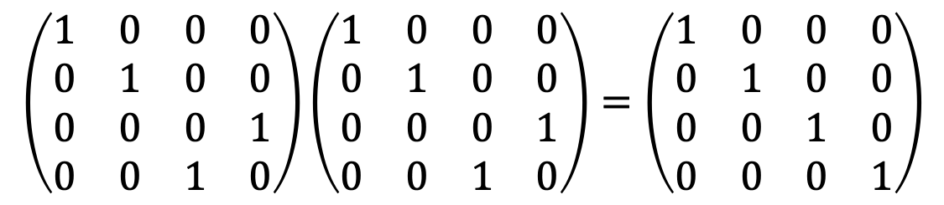




Simplifying Controlled Operations (1)
$$|0⟩$$
$$|0⟩$$
$$|0⟩$$
$$|0⟩$$
$$|S⟩$$
G
$$|S⟩$$
$$|S⟩$$
$$|S⟩$$
$$\left(\begin{matrix}1 & 0 & 0 & 0 \\ 0 & 1 & 0 & 0 \\ 0 & 0 & 0 & 1 \\ 0 & 0 & 1 & 0\end{matrix}\right)\left(\begin{matrix}1 & 0 & 0 & 0 \\ 0 & 1 & 0 & 0 \\ 0 & 0 & 0 & 1 \\ 0 & 0 & 1 & 0\end{matrix}\right)=\left(\begin{matrix}1 & 0 & 0 & 0 \\ 0 & 1 & 0 & 0 \\ 0 & 0 & 1 & 0 \\ 0 & 0 & 0 & 1\end{matrix}\right)$$
+
+
Notes:
In some cases, the application of two-qubit controlled gates does not change the state of the qubit pair.
If the control qubit is in the fixed state ∣0⟩, the controlled operation leaves the target unchanged. In this situation, the controlled gate is equivalent to two wires, since neither qubit undergoes any transformation.
Similarly, applying two consecutive CNOT gates on the same pair of qubits also has no effect. Their matrix product is the 4×4 dentity, so the overall action is equivalent to doing nothing.

Slide 10
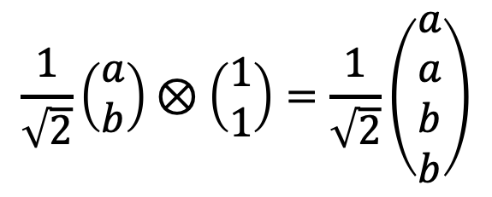

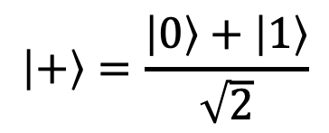

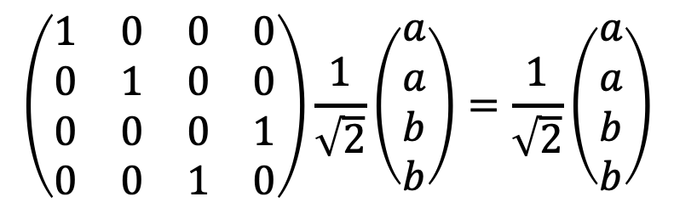

Simplifying Controlled Operations (2)
$$\left|S\right\rangle =a\left|0\right\rangle +b\left|1\right\rangle$$
$$|S⟩$$
$$\left|+\right\rangle =\frac{\left|0\right\rangle +\left|1\right\rangle }{\sqrt{2}}$$
+
$$|+⟩$$
Input:
$$\frac{1}{\sqrt{2}}\left(\begin{matrix}a \\ b\end{matrix}\right)⊗\left(\begin{matrix}1 \\ 1\end{matrix}\right)=\frac{1}{\sqrt{2}}\left(\begin{matrix}a \\ a \\ b \\ b\end{matrix}\right)$$
Output:
$$\left(\begin{matrix}1 & 0 & 0 & 0 \\ 0 & 1 & 0 & 0 \\ 0 & 0 & 0 & 1 \\ 0 & 0 & 1 & 0\end{matrix}\right)\frac{1}{\sqrt{2}}\left(\begin{matrix}a \\ a \\ b \\ b\end{matrix}\right)=\frac{1}{\sqrt{2}}\left(\begin{matrix}a \\ a \\ b \\ b\end{matrix}\right)$$
Notes:
It is interesting to look at the case where the target qubit at the input of a CNOT gate is in the state ∣+⟩. In this situation, no matter what state the control qubit is in, the output state stays the same. This happens because the CNOT flips the target, and flipping ∣+⟩ leaves it unchanged. In this specific case, the CNOT is equivalent to the identity and can be removed without affecting the circuit.
This can be checked directly by calculating the qubit states at the input and at the output of the circuit.

Slide 11

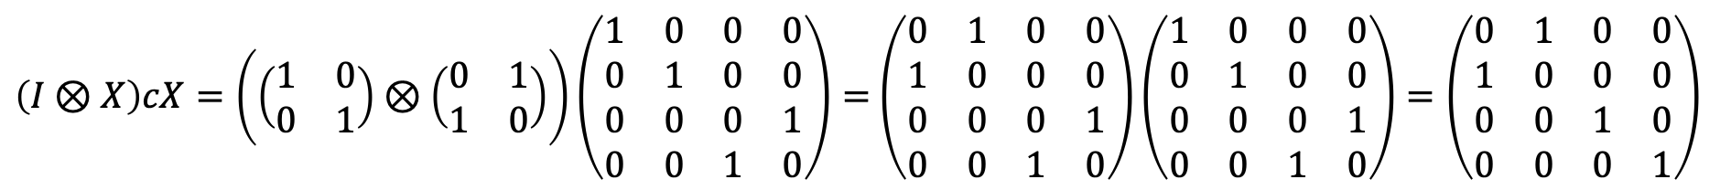
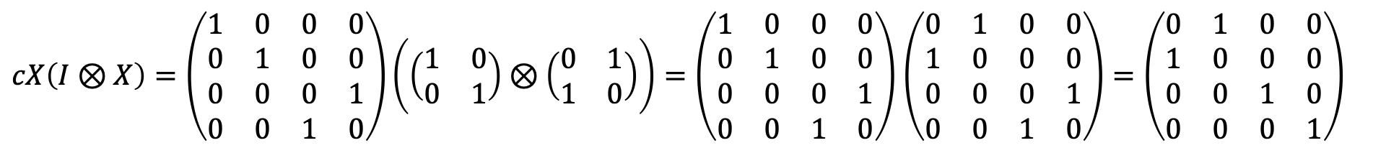
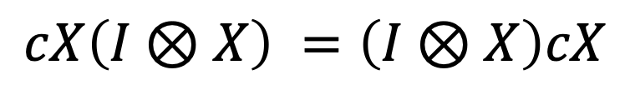
Commutativity of X and CNOT Gate
$$≡$$
+
+
+
+
$$cX\left(I⊗X\right) =\left(I⊗X\right)cX$$
$cX\left(I⊗X\right)=\left(\begin{matrix}1 & 0 & 0 & 0 \\ 0 & 1 & 0 & 0 \\ 0 & 0 & 0 & 1 \\ 0 & 0 & 1 & 0\end{matrix}\right)\left(\left(\begin{matrix}\text{1} & \text{0} \\ \text{0} & \text{1}\end{matrix}\right)⊗\left(\begin{matrix}\text{0} & \text{1} \\ \text{1} & \text{0}\end{matrix}\right)\right)=\left(\begin{matrix}1 & 0 & 0 & 0 \\ 0 & 1 & 0 & 0 \\ 0 & 0 & 0 & 1 \\ 0 & 0 & 1 & 0\end{matrix}\right)$ $\left(\begin{matrix}0 & 1 & 0 & 0 \\ 1 & 0 & 0 & 0 \\ 0 & 0 & 0 & 1 \\ 0 & 0 & 1 & 0\end{matrix}\right)=\left(\begin{matrix}0 & 1 & 0 & 0 \\ 1 & 0 & 0 & 0 \\ 0 & 0 & 1 & 0 \\ 0 & 0 & 0 & 1\end{matrix}\right)$
$\left(I⊗X\right)cX=\left(\left(\begin{matrix}\text{1} & \text{0} \\ \text{0} & \text{1}\end{matrix}\right)⊗\left(\begin{matrix}\text{0} & \text{1} \\ \text{1} & \text{0}\end{matrix}\right)\right)\left(\begin{matrix}1 & 0 & 0 & 0 \\ 0 & 1 & 0 & 0 \\ 0 & 0 & 0 & 1 \\ 0 & 0 & 1 & 0\end{matrix}\right)=$ $\left(\begin{matrix}0 & 1 & 0 & 0 \\ 1 & 0 & 0 & 0 \\ 0 & 0 & 0 & 1 \\ 0 & 0 & 1 & 0\end{matrix}\right)\left(\begin{matrix}1 & 0 & 0 & 0 \\ 0 & 1 & 0 & 0 \\ 0 & 0 & 0 & 1 \\ 0 & 0 & 1 & 0\end{matrix}\right)=\left(\begin{matrix}0 & 1 & 0 & 0 \\ 1 & 0 & 0 & 0 \\ 0 & 0 & 1 & 0 \\ 0 & 0 & 0 & 1\end{matrix}\right)$
Notes:
In certain applications, such as quantum circuit optimization, it is useful to rearrange the order of gates without affecting the state vector. Some gates, such as the Pauli-X gate and the Controlled-X (CNOT) gate, exhibit commutativity.
In the example shown in the image, the NOT gate and the CNOT gate can be swapped without changing the circuit's output state. This can be easily verified through matrix multiplication, where: $cX\left(I⊗X\right) =\left(I⊗X\right)cX$ showing that gate order does not affect the transformation.

Slide 12

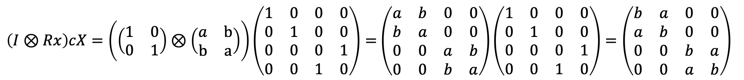
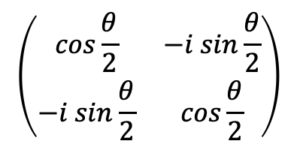

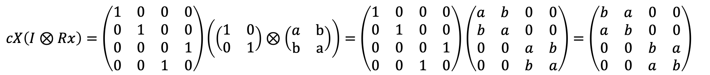

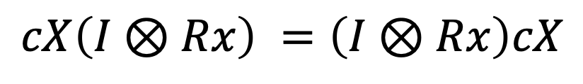


Commutativity of Rx and CNOT Gates
$$≡$$
$$a$$
$$b$$
+
+
$$\left(\begin{matrix}cos\frac{θ}{2} & −i sin\frac{θ}{2} \\ −i sin\frac{θ}{2} & cos\frac{θ}{2}\end{matrix}\right)$$
$$b$$
$$a$$
$$cX\left(I⊗Rx\right) =\left(I⊗Rx\right)cX$$
$cX\left(I⊗Rx\right)=\left(\begin{matrix}1 & 0 & 0 & 0 \\ 0 & 1 & 0 & 0 \\ 0 & 0 & 0 & 1 \\ 0 & 0 & 1 & 0\end{matrix}\right)\left(\left(\begin{matrix}\text{1} & \text{0} \\ \text{0} & \text{1}\end{matrix}\right)⊗\left(\begin{matrix}a & \text{b} \\ \text{b} & \text{a}\end{matrix}\right)\right)=\left(\begin{matrix}1 & 0 & 0 & 0 \\ 0 & 1 & 0 & 0 \\ 0 & 0 & 0 & 1 \\ 0 & 0 & 1 & 0\end{matrix}\right)$ $\left(\begin{matrix}a & b & 0 & 0 \\ b & a & 0 & 0 \\ 0 & 0 & a & b \\ 0 & 0 & b & a\end{matrix}\right)=\left(\begin{matrix}b & a & 0 & 0 \\ a & b & 0 & 0 \\ 0 & 0 & b & a \\ 0 & 0 & a & b\end{matrix}\right)$
$\left(I⊗Rx\right)cX=\left(\left(\begin{matrix}\text{1} & \text{0} \\ \text{0} & \text{1}\end{matrix}\right)⊗\left(\begin{matrix}a & \text{b} \\ \text{b} & \text{a}\end{matrix}\right)\right)\left(\begin{matrix}1 & 0 & 0 & 0 \\ 0 & 1 & 0 & 0 \\ 0 & 0 & 0 & 1 \\ 0 & 0 & 1 & 0\end{matrix}\right)=$ $\left(\begin{matrix}a & b & 0 & 0 \\ b & a & 0 & 0 \\ 0 & 0 & a & b \\ 0 & 0 & b & a\end{matrix}\right)\left(\begin{matrix}1 & 0 & 0 & 0 \\ 0 & 1 & 0 & 0 \\ 0 & 0 & 0 & 1 \\ 0 & 0 & 1 & 0\end{matrix}\right)=\left(\begin{matrix}b & a & 0 & 0 \\ a & b & 0 & 0 \\ 0 & 0 & b & a \\ 0 & 0 & a & b\end{matrix}\right)$
Notes:
It is useful to note that the Rx gate and the CNOT commute when Rx is applied to the target qubit. In other words, the two gates can be swapped without changing the circuit’s output.
To verify this, the Rx matrix can be written in a simpler form by setting $a=\cos{θ/2}$ and b$=−\sin{θ/2}$. Using these substitutions makes the matrix multiplication easier.
After carrying out the multiplication, the transformation matrices of both circuit orders turn out to be identical. This confirms that Rx and CNOT commute when the rotation is applied to the target qubit.
However, if Rx is applied to the control qubit, commutativity does not hold, because the rotation changes the control state before the CNOT acts.

Slide 13
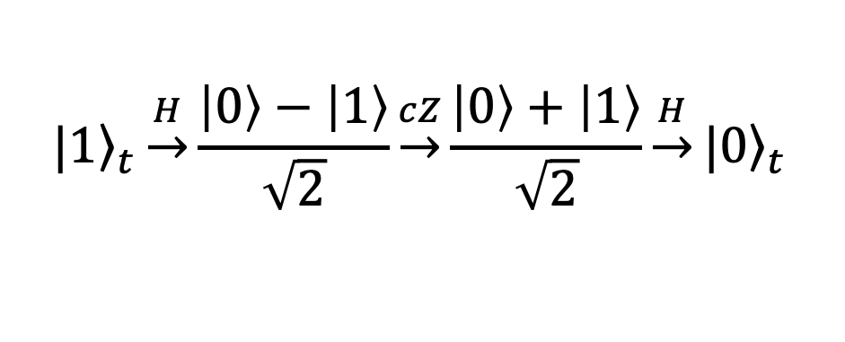
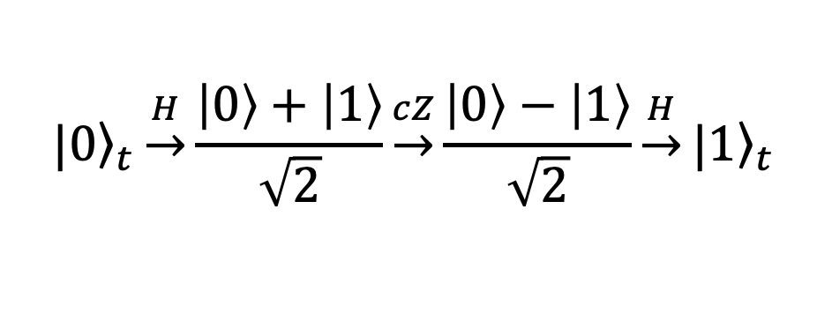
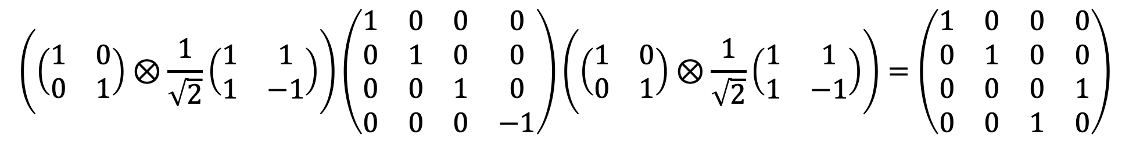
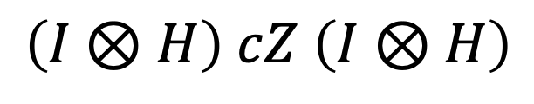
Decomposing CX Gate
c
I
I
$$≡$$
$$\left(I⊗H\right) cZ \left(I⊗H\right)$$
t
+
H
Z
H
$${\left.|0\right\rangle }_{t}\underset{→}{H}\frac{\left|0\right\rangle +\left|1\right\rangle }{\sqrt{2}}\underset{→}{cZ}\frac{\left|0\right\rangle −\left|1\right\rangle }{\sqrt{2}}\underset{→}{H}{\left.|1\right\rangle }_{t}$$
$${\left.|1\right\rangle }_{t}\underset{→}{H}\frac{\left|0\right\rangle −\left|1\right\rangle }{\sqrt{2}}\underset{→}{cZ}\frac{\left|0\right\rangle +\left|1\right\rangle }{\sqrt{2}}\underset{→}{H}{\left.|0\right\rangle }_{t}$$
$$\left(\left(\begin{matrix}\text{1} & \text{0} \\ \text{0} & \text{1}\end{matrix}\right)⊗\frac{\text{1}}{\sqrt{\text{2}}}\left(\begin{matrix}\text{1} & \text{1} \\ \text{1} & \text{−1}\end{matrix}\right)\right)\left(\begin{matrix}1 & 0 & 0 & 0 \\ 0 & 1 & 0 & 0 \\ 0 & 0 & 1 & 0 \\ 0 & 0 & 0 & −1\end{matrix}\right)\left(\left(\begin{matrix}\text{1} & \text{0} \\ \text{0} & \text{1}\end{matrix}\right)⊗\frac{\text{1}}{\sqrt{\text{2}}}\left(\begin{matrix}\text{1} & \text{1} \\ \text{1} & \text{−1}\end{matrix}\right)\right)=\left(\begin{matrix}1 & 0 & 0 & 0 \\ 0 & 1 & 0 & 0 \\ 0 & 0 & 0 & 1 \\ 0 & 0 & 1 & 0\end{matrix}\right)$$
Notes:
The CX gate can be decomposed into a sequence of simpler gates, as shown on the slide. To check the correctness of this substitution, let’s look at specific cases.
Control = ∣1⟩, Target = ∣0⟩:
The first Hadamard puts the target into ∣+⟩.
The controlled-Z flips the phase, giving ∣−⟩.
The second Hadamard cancels the superposition and turns the target into ∣1⟩.
Control = ∣1⟩, Target = ∣1⟩:
The first Hadamard turns the target into ∣−⟩.
The controlled-Z flips the phase, giving ∣+⟩.
The second Hadamard restores the target to ∣0⟩.
Control = ∣0⟩:
The controlled-Z has no effect, and the two Hadamards cancel out. The target qubit remains unchanged.
We can also confirm this equivalence with matrices. Adding an identity on the control, the circuit is expressed as $\left(I⊗H\right) cZ \left(I⊗H\right)$. Multiplying the matrices shows that this operator is identical to the CX matrix, proving that the decomposition is correct.

Slide 14
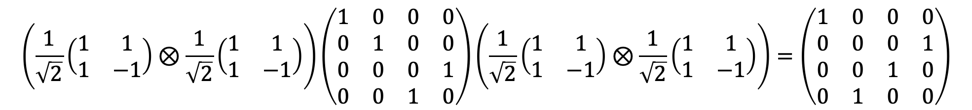
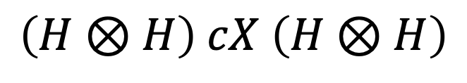
Mirrored-control: Swapping Control and Target
t
+
H
H
+
$$≡$$
c
H
H
$$\left(H⊗H\right) cX \left(H⊗H\right)$$
$$\left(\frac{\text{1}}{\sqrt{\text{2}}}\left(\begin{matrix}\text{1} & \text{1} \\ \text{1} & \text{−1}\end{matrix}\right)⊗\frac{\text{1}}{\sqrt{\text{2}}}\left(\begin{matrix}\text{1} & \text{1} \\ \text{1} & \text{−1}\end{matrix}\right)\right)\left(\begin{matrix}1 & 0 & 0 & 0 \\ 0 & 1 & 0 & 0 \\ 0 & 0 & 0 & 1 \\ 0 & 0 & 1 & 0\end{matrix}\right)\left(\frac{\text{1}}{\sqrt{\text{2}}}\left(\begin{matrix}\text{1} & \text{1} \\ \text{1} & \text{−1}\end{matrix}\right)⊗\frac{\text{1}}{\sqrt{\text{2}}}\left(\begin{matrix}\text{1} & \text{1} \\ \text{1} & \text{−1}\end{matrix}\right)\right)=\left(\begin{matrix}1 & 0 & 0 & 0 \\ 0 & 0 & 0 & 1 \\ 0 & 0 & 1 & 0 \\ 0 & 1 & 0 & 0\end{matrix}\right)$$
Notes:
In some situations, we may need a mirrored control X gate, where the upper qubit is the target and the lower qubit is the control. However, hardware connectivity often prevents us from wiring the qubits this way directly.
This problem can be solved by using a standard CX gate, sandwiched between Hadamard gates on both qubits. From the diagram, the overall transformation is given by $\left(H⊗H\right) cX \left(H⊗H\right)$.
Carrying out the matrix multiplication shows that this circuit produces exactly the reverse-controlled-X matrix. The Hadamards switch the basis, which swaps the roles of control and target, so the CX ends up acting in reverse.

Slide 15

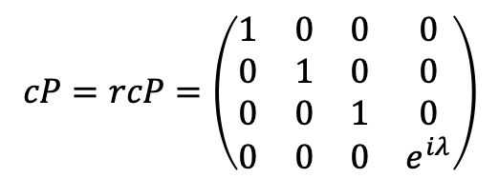
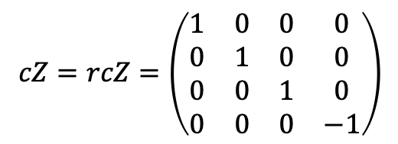
CZ and CP Symmetry Property
Z
$$cZ=rcZ=\left(\begin{matrix}1 & 0 & 0 & 0 \\ 0 & 1 & 0 & 0 \\ 0 & 0 & 1 & 0 \\ 0 & 0 & 0 & −1\end{matrix}\right)$$
$$≡$$
Z
P
$$cP=rcP=\left(\begin{matrix}1 & 0 & 0 & 0 \\ 0 & 1 & 0 & 0 \\ 0 & 0 & 1 & 0 \\ 0 & 0 & 0 & e^{iλ}\end{matrix}\right)$$
$$≡$$
P
Notes:
The controlled-Z (CZ) and controlled-P (CP) gates have a special symmetry: swapping the control and target qubits does not change the transformation matrix.
This happens because both Z and P are diagonal gates. Since they only add a phase and do not flip states, it makes no difference which qubit acts as control.
Because of this symmetry, the CZ gate is often drawn simply as two connected dots, without distinguishing control from target.

Slide 16

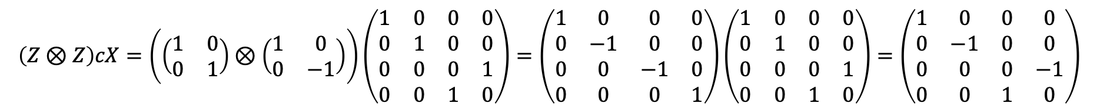
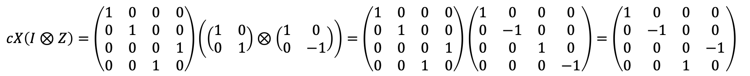
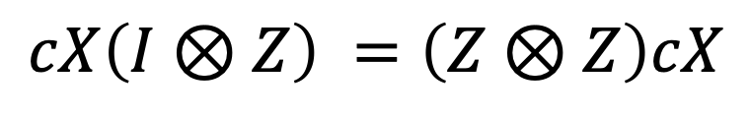
Commutation of Z and CNOT
Z
$$≡$$
Z
+
+
Z
$$cX\left(I⊗Z\right) =\left(Z⊗Z\right)cX$$
$cX\left(I⊗Z\right)=\left(\begin{matrix}1 & 0 & 0 & 0 \\ 0 & 1 & 0 & 0 \\ 0 & 0 & 0 & 1 \\ 0 & 0 & 1 & 0\end{matrix}\right)\left(\left(\begin{matrix}\text{1} & \text{0} \\ \text{0} & \text{1}\end{matrix}\right)⊗\left(\begin{matrix}1 & \text{0} \\ 0 & −1\end{matrix}\right)\right)=\left(\begin{matrix}1 & 0 & 0 & 0 \\ 0 & 1 & 0 & 0 \\ 0 & 0 & 0 & 1 \\ 0 & 0 & 1 & 0\end{matrix}\right)$ $\left(\begin{matrix}1 & 0 & 0 & 0 \\ 0 & −1 & 0 & 0 \\ 0 & 0 & 1 & 0 \\ 0 & 0 & 0 & −1\end{matrix}\right)=\left(\begin{matrix}1 & 0 & 0 & 0 \\ 0 & −1 & 0 & 0 \\ 0 & 0 & 0 & −1 \\ 0 & 0 & 1 & 0\end{matrix}\right)$
$$\left(Z⊗Z\right)cX=\left(\left(\begin{matrix}\text{1} & \text{0} \\ \text{0} & \text{1}\end{matrix}\right)⊗\left(\begin{matrix}1 & \text{0} \\ 0 & −1\end{matrix}\right)\right)\left(\begin{matrix}1 & 0 & 0 & 0 \\ 0 & 1 & 0 & 0 \\ 0 & 0 & 0 & 1 \\ 0 & 0 & 1 & 0\end{matrix}\right)=\left(\begin{matrix}1 & 0 & 0 & 0 \\ 0 & −1 & 0 & 0 \\ 0 & 0 & −1 & 0 \\ 0 & 0 & 0 & 1\end{matrix}\right)\left(\begin{matrix}1 & 0 & 0 & 0 \\ 0 & 1 & 0 & 0 \\ 0 & 0 & 0 & 1 \\ 0 & 0 & 1 & 0\end{matrix}\right)=\left(\begin{matrix}1 & 0 & 0 & 0 \\ 0 & −1 & 0 & 0 \\ 0 & 0 & 0 & −1 \\ 0 & 0 & 1 & 0\end{matrix}\right)$$
Notes:
The Z gate commutes with the CNOT, distributing onto both the control and target qubits.
Consider the circuit on the left, where a Z gate is applied to the target qubit before a CNOT. This setup is equivalent to a circuit where Z gates are applied to both the control and the target qubits after the CNOT.
In Dirac notation, this relationship is written as $cX\left(I⊗Z\right) =\left(Z⊗Z\right)cX$ and it can also be verified directly by matrix multiplication.
Intuitively, you can think of it like this: the Z gate “passes through” the CNOT, but in the process it leaves a copy of itself on the control qubit.

Slide 17
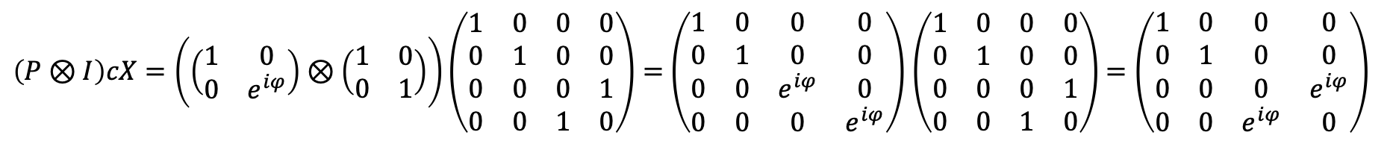
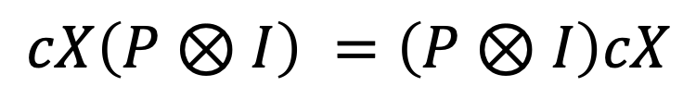
Commutation of P and CNOT
P
P
$$≡$$
+
+
$$cX\left(P⊗I\right) =\left(P⊗I\right)cX$$
$cX\left(P⊗I\right)=\left(\begin{matrix}1 & 0 & 0 & 0 \\ 0 & 1 & 0 & 0 \\ 0 & 0 & 0 & 1 \\ 0 & 0 & 1 & 0\end{matrix}\right)\left(\left(\begin{matrix}1 & \text{0} \\ \text{0} & e^{iφ}\end{matrix}\right)⊗\left(\begin{matrix}\text{1} & \text{0} \\ \text{0} & \text{1}\end{matrix}\right)\right)=\left(\begin{matrix}1 & 0 & 0 & 0 \\ 0 & 1 & 0 & 0 \\ 0 & 0 & 0 & 1 \\ 0 & 0 & 1 & 0\end{matrix}\right)$ $\left(\begin{matrix}1 & 0 & 0 & 0 \\ 0 & 1 & 0 & 0 \\ 0 & 0 & e^{iφ} & 0 \\ 0 & 0 & 0 & e^{iφ}\end{matrix}\right)$ $=\left(\begin{matrix}1 & 0 & 0 & 0 \\ 0 & 1 & 0 & 0 \\ 0 & 0 & 0 & e^{iφ} \\ 0 & 0 & e^{iφ} & 0\end{matrix}\right)$
$\left(P⊗I\right)cX=\left(\left(\begin{matrix}1 & \text{0} \\ \text{0} & e^{iφ}\end{matrix}\right)⊗\left(\begin{matrix}\text{1} & \text{0} \\ \text{0} & \text{1}\end{matrix}\right)\right)\left(\begin{matrix}1 & 0 & 0 & 0 \\ 0 & 1 & 0 & 0 \\ 0 & 0 & 0 & 1 \\ 0 & 0 & 1 & 0\end{matrix}\right)=$ $\left(\begin{matrix}1 & 0 & 0 & 0 \\ 0 & 1 & 0 & 0 \\ 0 & 0 & e^{iφ} & 0 \\ 0 & 0 & 0 & e^{iφ}\end{matrix}\right)$ $\left(\begin{matrix}1 & 0 & 0 & 0 \\ 0 & 1 & 0 & 0 \\ 0 & 0 & 0 & 1 \\ 0 & 0 & 1 & 0\end{matrix}\right)$ $=\left(\begin{matrix}1 & 0 & 0 & 0 \\ 0 & 1 & 0 & 0 \\ 0 & 0 & 0 & e^{iφ} \\ 0 & 0 & e^{iφ} & 0\end{matrix}\right)$
Notes:
The P gate commutes with the CNOT when applied to the control qubit, leaving the circuit unchanged. Intuitively, this works because the P gate only adds a phase to the control qubit, and that phase does not change how the CNOT flips the target.
This can be confirmed by matrix multiplication, which shows that the order of applying the gates does not affect the result.

Slide 18
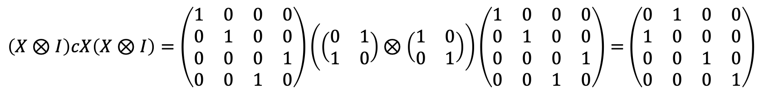
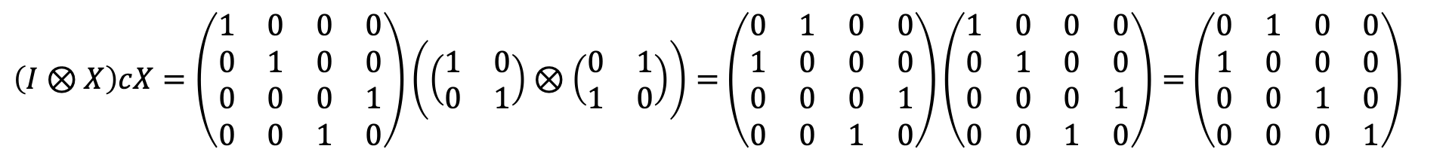
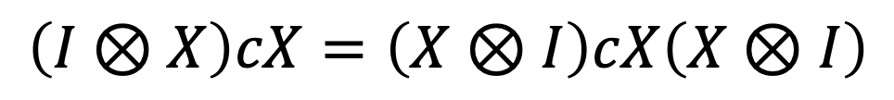
X–CNOT Commutation Rule
+
+
$$≡$$
+
+
+
$$\left(I⊗X\right)cX=\left(X⊗I\right)cX\left(X⊗I\right)$$
$\left(I⊗X\right)cX=\left(\begin{matrix}1 & 0 & 0 & 0 \\ 0 & 1 & 0 & 0 \\ 0 & 0 & 0 & 1 \\ 0 & 0 & 1 & 0\end{matrix}\right)\left(\left(\begin{matrix}\text{1} & \text{0} \\ \text{0} & \text{1}\end{matrix}\right)⊗\left(\begin{matrix}\text{0} & \text{1} \\ \text{1} & \text{0}\end{matrix}\right)\right)=$ $\left(\begin{matrix}0 & 1 & 0 & 0 \\ 1 & 0 & 0 & 0 \\ 0 & 0 & 0 & 1 \\ 0 & 0 & 1 & 0\end{matrix}\right)\left(\begin{matrix}1 & 0 & 0 & 0 \\ 0 & 1 & 0 & 0 \\ 0 & 0 & 0 & 1 \\ 0 & 0 & 1 & 0\end{matrix}\right)=$ $\left(\begin{matrix}0 & 1 & 0 & 0 \\ 1 & 0 & 0 & 0 \\ 0 & 0 & 1 & 0 \\ 0 & 0 & 0 & 1\end{matrix}\right)$
$\left(X⊗I\right)cX\left(X⊗I\right)=\left(\begin{matrix}1 & 0 & 0 & 0 \\ 0 & 1 & 0 & 0 \\ 0 & 0 & 0 & 1 \\ 0 & 0 & 1 & 0\end{matrix}\right)\left(\left(\begin{matrix}\text{0} & \text{1} \\ \text{1} & \text{0}\end{matrix}\right)⊗\left(\begin{matrix}\text{1} & \text{0} \\ \text{0} & \text{1}\end{matrix}\right)\right)\left(\begin{matrix}1 & 0 & 0 & 0 \\ 0 & 1 & 0 & 0 \\ 0 & 0 & 0 & 1 \\ 0 & 0 & 1 & 0\end{matrix}\right)=$ $\left(\begin{matrix}0 & 1 & 0 & 0 \\ 1 & 0 & 0 & 0 \\ 0 & 0 & 1 & 0 \\ 0 & 0 & 0 & 1\end{matrix}\right)$
Notes:
A CNOT gate followed by an X gate on the target qubit is equivalent to a CNOT gate sandwiched between two Pauli-XXX gates on the control qubit.
From this equivalence, we can draw an important conclusion that flipping the target output of the CNOT has the same effect as flipping the control qubit at the input. The extra X on the control output is then needed to restore the control qubit back to its original state.

Slide 19
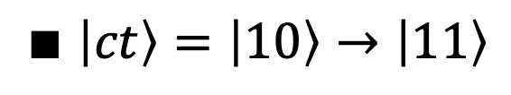
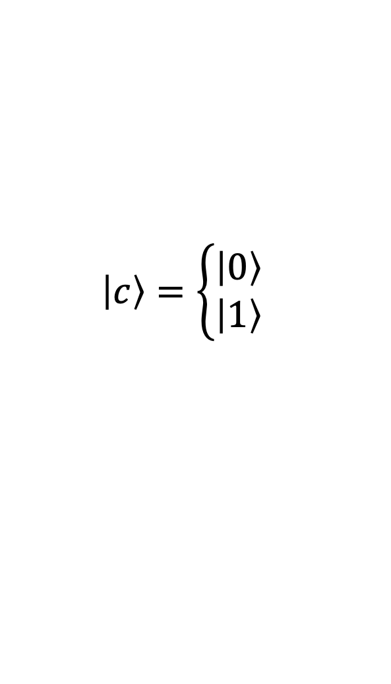
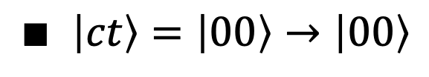

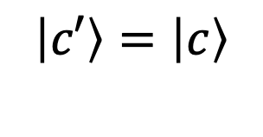


CNOT as a Copier
$$\left|c\right\rangle =\left\{\begin{matrix}\left|0\right\rangle \\ \left|1\right\rangle \end{matrix}\right.$$
$$\left|c′\right\rangle =\left|c\right\rangle$$
$$\left|cc\right\rangle$$
+
$$\left|t\right\rangle = \left|0\right\rangle$$
$$\left|t′\right\rangle =\left|c\right\rangle$$
When $\left|t\right\rangle = \left|0\right\rangle$, the target qubit becomes a copy of the control qubit:
$$∎ \left|ct\right\rangle =\left|00\right\rangle →\left|00\right\rangle$$
$$∎ \left|ct\right\rangle =\left|10\right\rangle →\left|11\right\rangle$$
Notes:
When the target qubit is ∣0⟩, the CNOT acts as a copier of the control qubit.
If the control is ∣0⟩, the target remains ∣0⟩, giving the output ∣00⟩.
If the control is ∣1⟩, the target flips to ∣1⟩, giving the output ∣11⟩.
In both cases, the control qubit is effectively copied onto the target. However, this only works when the control is in a basis state.

Slide 20






Mirror Symmetry of CNOT with H Gates
H
+
H
+
$$≡$$
H
H
$$⊗2$$
$$⊗2$$
$$H cX=rcXH$$
$$\left(\begin{matrix}1 & 0 & 0 & 0 \\ 0 & 1 & 0 & 0 \\ 0 & 0 & 0 & 1 \\ 0 & 0 & 1 & 0\end{matrix}\right)\left(\frac{\text{1}}{\sqrt{\text{2}}}\left(\begin{matrix}\text{1} & \text{1} \\ \text{1} & \text{−1}\end{matrix}\right)⊗\frac{\text{1}}{\sqrt{\text{2}}}\left(\begin{matrix}\text{1} & \text{1} \\ \text{1} & \text{−1}\end{matrix}\right)\right)=\frac{1}{2}\left(\begin{matrix}1 & 1 & 1 & 1 \\ 1 & −1 & 1 & −1 \\ 1 & −1 & −1 & 1 \\ 1 & 1 & −1 & −1\end{matrix}\right)$$
$$\left(\frac{\text{1}}{\sqrt{\text{2}}}\left(\begin{matrix}\text{1} & \text{1} \\ \text{1} & \text{−1}\end{matrix}\right)⊗\frac{\text{1}}{\sqrt{\text{2}}}\left(\begin{matrix}\text{1} & \text{1} \\ \text{1} & \text{−1}\end{matrix}\right)\right)\left(\begin{matrix}1 & 0 & 0 & 0 \\ 0 & 0 & 0 & 1 \\ 0 & 0 & 1 & 0 \\ 0 & 1 & 0 & 0\end{matrix}\right)=\frac{1}{2}\left(\begin{matrix}1 & 1 & 1 & 1 \\ 1 & −1 & 1 & −1 \\ 1 & −1 & −1 & 1 \\ 1 & 1 & −1 & −1\end{matrix}\right)$$
Notes:
Two parallel Hadamard gates, followed by a CNOT gate, can be replaced by their mirror image. In other words, applying Hadamards to both qubits before a CNOT is equivalent to applying a reverse-controlled-X after the Hadamards. This equivalence can be confirmed in the usual way by multiplying the matrices of both circuits and seeing that they match.
Intuitively, the Hadamards switch the computational basis to the diagonal basis. In this new basis, the roles of control and target are swapped, so the CNOT effectively becomes a reverse-CNOT.

Slide 21







How a Compiler Routes a CNOT
$$\left|C\right\rangle$$
$$\left|A\right\rangle$$
$$≡$$
+
+
$$≡$$
+
+
$$\left|T\right\rangle$$
+
+
+
+
+
$$\left|CAT\right\rangle →\left|CA\right\rangle \left|C⨁T\right\rangle$$
$$(L⨁L=0)$$
$\left|CAT\right\rangle →\left|C\right\rangle$ $\left|A⨁C\right\rangle \left|T\right\rangle →\left|C\right\rangle \left|A⨁C\right\rangle \left|A⨁C⨁T\right\rangle →\left|CA\right\rangle \left|A⨁C⨁T\right\rangle →\left|CA\right\rangle$ $\left|C⨁T\right\rangle$
$\left|CAT\right\rangle →\left|CA\right\rangle$ $\left|A⨁T\right\rangle →\left|C\right\rangle \left|A⨁C\right\rangle \left|A⨁T\right\rangle →\left|C\right\rangle \left|A⨁C\right\rangle \left|C⨁T\right\rangle →\left|CA\right\rangle \left|C⨁T\right\rangle$
Notes:
One of the tasks of a quantum compiler is to find a path between the control and target qubits when no direct hardware connection exists. Suppose a program specifies a CNOT gate between qubits C and T, but there is no direct link between them. However, there is a connection between C and an auxiliary qubit A, as well as between A and T.
Start: We begin with the three-qubit state ∣CAT⟩.
Step 1: CNOT from C to A: The auxiliary qubit picks up the value of the control. So A becomes A⊕C.
Step 2: CNOT from A to T: Now the target flips depending on A. Its value becomes T⊕(A⊕C).
Step 3: CNOT from C to A again: We undo the extra change on A. Since we added C twice, it cancels out, and A goes back to its original value.
Step 4 – CNOT from A to T again: Finally, the target flips once more, this time cancelling out the leftover A. What’s left is simply T⊕C.
The auxiliary qubit is restored to what it was at the start, and the target has flipped exactly as if there had been a direct CNOT from C to T.
An alternative strategy works in the reverse order:
First apply a CNOT between A and T.
Then apply a CNOT between C and A.
Finally, repeat the sequence.
Tracing the states through this circuit again shows that the correct output is obtained.
This analysis illustrates how a quantum compiler can insert intermediate qubits and gate sequences to “route” an operation across the hardware, even when a direct connection is missing.

Slide 22

Mirror symmetry of CNOT gates
+
$$≡$$
+
+
+
+
+
+
$$≡$$
+
+
+
+
+
Notes:
An interesting equivalence arises where CNOT gates behave like mirror images.
The circuit shown includes a CNOT gate between the first and third qubits, followed by a pair of CNOT gates involving the middle qubit. It can be shown that shifting the initial CNOT gate from the left to the right side of the group does not alter the circuit’s final state.
The same holds true if the two CNOT gates within the group switch places. Even in this configuration, moving the initial CNOT from the left to the right side of the group leaves the circuit’s state unchanged.

Slide 23


Building the SWAP Gate
a
(a⨁b)⨁a=b
b
a
b
$$a=a XOR b$$
$$b=b XOR a$$
$$a=a XOR b$$
a
b
+
b
a
+
+
a⨁b
a⨁b
b ⨁(a⨁b)=a
XOR swap algorithm
gate swap a,b { cx a,b; cx b,a; cx a,b; }
$\left(\begin{matrix}1 & 0 & 0 & 0 \\ 0 & 1 & 0 & 0 \\ 0 & 0 & 0 & 1 \\ 0 & 0 & 1 & 0\end{matrix}\right)$ $\left(\begin{matrix}1 & 0 & 0 & 0 \\ 0 & 0 & 0 & 1 \\ 0 & 0 & 1 & 0 \\ 0 & 1 & 0 & 0\end{matrix}\right)$ $\left(\begin{matrix}1 & 0 & 0 & 0 \\ 0 & 1 & 0 & 0 \\ 0 & 0 & 0 & 1 \\ 0 & 0 & 1 & 0\end{matrix}\right)=\left(\begin{matrix}1 & 0 & 0 & 0 \\ 0 & 0 & 1 & 0 \\ 0 & 1 & 0 & 0 \\ 0 & 0 & 0 & 1\end{matrix}\right)$
cX
rcX
cX
SWAP
Notes:
The SWAP gate is used to exchange the states of two qubits. It is not a basic hardware gate but a composite gate built from three CNOTs, following the XOR swap algorithm. This method is efficient because it requires no extra memory, and the algorithm itself can be written in just three lines of code.
Step-by-step through the circuit:
Input: qubits (a,b).
After the first CNOT: the control remains a, and the target becomes a⊕b.
After the second CNOT: the control is now a⊕b, and the target simplifies to b.
After the third CNOT: the control is b, and the target simplifies becomes a.
At the output, the two qubits have exchanged states, (a,b)↦(b,a).
To prove correctness, we multiply the operators, CNOT, reverse CNOT, and CNOT. The result is exactly the unitary matrix of the SWAP gate.

Slide 24











Z-Y-Z Decomposition Theorem
Any single-qubit unitary operator $U∈SU(2)$
can be decomposed into a sequence of three rotations about two fixed axes
$${U=R}_{z}\left(α_{1}\right)R_{y}\left(θ\right)R_{z}\left(α_{2}\right)$$
where $α_{1},α_{2}, and$ $θ$are real rotation angles.
$$α_{1}$$
$$z$$
$$α_{2}$$
$$\left|S\right\rangle$$
$\left|S′\right\rangle =U$ $\left|S\right\rangle$
$$θ$$
$${U=R}_{z}\left(α_{1}\right)R_{y}\left(θ\right)R_{z}\left(α_{2}\right)$$
$$y$$
$$x$$
$$U=\left(\begin{matrix}e^{−i\frac{α_{1}}{2}} & 0 \\ 0 & e^{i\frac{α_{1}}{2}}\end{matrix}\right)\left(\begin{matrix}cos\frac{θ}{2} & −sin\frac{θ}{2} \\ sin\frac{θ}{2} & cos\frac{θ}{2}\end{matrix}\right)\left(\begin{matrix}e^{−i\frac{α_{2}}{2}} & 0 \\ 0 & e^{i\frac{α_{2}}{2}}\end{matrix}\right)$$
Notes:
A qubit state can be visualized as a vector on the Bloch sphere. The state can be changed by rotating the vector around the sphere. The decomposition theorem states that any unitary operator acting on a single qubit can be written as a sequence of rotations around just two distinct axes.
A widely used form is a rotation about the z-axis, followed by a rotation about the y-axis, and then another rotation about the z-axis.

Slide 25










Lemma 1 of the Decomposition Theorem
Lemma:
There exist operators A, B and C such that :
$$\begin{matrix}U=AXBXC where ABC=I & & & & \end{matrix}$$
Proof: If the rotation operators are chosen such that
$$A=R_{z}\left(α_{1}\right)R_{y}\left(θ/2\right)$$
$$R\left(0\right)=I$$
$$B=R_{y}\left(−θ/2\right)R_{z}\left({−(α_{2}+α}_{1})/2\right)$$
since
$$R\left(α\right)R\left(β\right)=R\left(α+β\right)$$
$$C=R_{z}\left({\left(α_{2}−α\right.}_{1})/2\right)$$
$$XRy,z\left(α\right)X=R\left(−α\right)$$
$$XX=I$$
$$ABC=I$$
$${AXBXC=R}_{z}\left(α_{1}\right)R_{y}\left(θ\right)R_{z}\left(α_{2}\right)=U$$
Notes:
The first lemma of the decomposition theorem states that there exist operators A,B and C such that $U=AXBXC$ where their product satisfies $ABC=I$
To outline the proof, we choose the rotation operators as follows:
$A=R_{z}\left(α_{1}\right)R_{y}\left(θ/2\right)$, $B=R_{y}\left(−θ/2\right)R_{z}\left({−(α_{2}+α}_{1})/2\right)$ and $C=R_{z}\left({\left(α_{2}−α\right.}_{1})/2\right)$
we rely on several facts we have already established:
a rotation with angle 0 is the identity,
two rotations about the same axis combine into a single rotation with the sum of the angles,
an XRX sequence flips the sign of the rotation angle,
two Hermitian gates applied in sequence give the identity.
With these properties it is possible to select the angles in a way that ensures the condition $ABC=I$ holds.
In practical terms, this lemma tells us that any single-qubit unitary operator can be built using the Pauli-X gate together with three other gates whose product is the identity.

Slide 26


Lemma 2 of the Decomposition Theorem
$$\begin{matrix}if U=AXBXC and ABC=I then: & & & & \end{matrix}$$
c
+
+
U
t
C
B
A
Proof:
$$if c=\left|0\right\rangle then ABC=I$$
$$if c=\left|1\right\rangle then AXBXC=U$$
Notes:
The second lemma extends the decomposition theorem to controlled gates.
The lemma states that if a unitary operator $U$ can be expressed as a product $AXBXC$ with $ABC=I$, then the controlled operator $cU$ can be implemented using three single-qubit gates and two CNOT gates, arranged as shown in the figure.
The lemma can be proven by looking at the circuit.
If the control qubit is $c=\left|0\right\rangle$, the controlled-X gates remain inactive, and the entire circuit reduces to the identity, $ABC=I$.
If the control qubit is $c=\left|1\right\rangle$, the controlled-X gates are active, and the entire circuit implements the transformation $AXBXC=U$.

Slide 27


Lemma 3 of the Decomposition Theorem
P
$$≡$$
$$Φ\left(φ\right)=\left(\begin{matrix}e^{iφ} & \text{0} \\ \text{0} & e^{iφ}\end{matrix}\right)$$
$$\begin{matrix}CΦ: & \left|00\right\rangle →\left|00\right\rangle & \left|01\right\rangle →\left|01\right\rangle & \left|10\right\rangle →e^{iφ}\left|10\right\rangle & \left|11\right\rangle →e^{iφ}\left|11\right\rangle \\ P⊗I: & \left|00\right\rangle →\left|00\right\rangle & \left|01\right\rangle →\left|01\right\rangle & \left|10\right\rangle →e^{iφ}\left|10\right\rangle & \left|11\right\rangle →e^{iφ}\left|11\right\rangle \end{matrix}$$
Notes:
To complete the design of the controlled circuit, we also need to include a phase factor. We define the operator Φ as a global phase determined by the angle φ, multiplied by the identity operator.
Lemma 3 states that a controlled-Φ gate is equivalent to applying a phase gate P on the control qubit.
The proof is straightforward. By comparing the input–output behavior of the two circuits, we see they perform the same transformation:
$$\begin{matrix}CΦ: & \left|00\right\rangle →\left|00\right\rangle & \left|01\right\rangle →\left|01\right\rangle & \left|10\right\rangle →e^{iφ}\left|10\right\rangle & \left|11\right\rangle →e^{iφ}\left|11\right\rangle \\ P⊗I: & \left|00\right\rangle →\left|00\right\rangle & \left|01\right\rangle →\left|01\right\rangle & \left|10\right\rangle →e^{iφ}\left|10\right\rangle & \left|11\right\rangle →e^{iφ}\left|11\right\rangle \end{matrix}$$
Since the mappings are identical, the circuits in the figure are equivalent, which completes the proof of the lemma.

Slide 28




Decomposition of the Controlled Gate
+
+
C
B
A
$$Φ$$
$$cU=cΦc(AXBXC)$$
$$≡$$
U
$$U=ΦAXBXC where ABC=I$$
P
+
+
C
B
A
$$cU=\left(P⨂A\right)cX\left(I⨂B\right)cX\left(I⨂C\right)$$
Notes:
With the proof of the previous lemma, the phase factor has now been incorporated into the decomposition of the controlled two-qubit gate.
We can state that the controlled-U gate can be constructed using a controlled-AXBXC circuit with an additional controlled phase factor Φ.
Based on the results of Lemma 3, the controlled phase factor circuit can be replaced by a single phase gate P, leading to the final configuration shown in the bottom circuit.

Slide 29







C²(U) Gate Construction
$$c_{1}$$
$$c_{1}$$
+
+
$$U=V^{2}$$
$$c_{2}$$
$$c_{2}$$
$$≡$$
$$t$$
U
$$t$$
V
V†
V
Notes:
Building on the previous results, we can now show the equivalence of the two circuits in the figure.
The double-controlled-U gate on the left is equivalent to the circuit on the right, provided that $U=V^{2}$. Circuits of this type are known as C²(U) circuits. The proof comes from tracking the states of the qubits step by step:
The first controlled-V gate is activated only if the control qubit $c_{2}$ is ∣1⟩.
The middle controlled-V† gate is active only if $c_{1}⊕c_{2}=1$. In other words, when the controls differ, V† cancels the effect of the earlier V.
The second CNOT restores qubit $c_{2}$​ to its original state, as required for any controlled operation.
Finally, the second controlled-$V$ gate is triggered if $c_{1}=\left|1\right\rangle$. This ensures that V is applied twice, i.e., $V^{2}=U$, only when both controls are set to ∣1⟩.
So, the circuit on the right correctly implements a double-controlled-U gate, confirming the equivalence under the condition $U=V^{2}$.

Slide 30



C^{n-1}(U) Gate Construction
$$≈$$
$$≈$$
$$≈$$
$$U=V^{2^{(n−1)}}$$
$$≡$$
+
+
U
V
V†
V
Notes:
The same idea can be extended to a circuit with n−1 control qubits.
The principle is the same as in the two-control case. We break down the unitary U into smaller gates V, chosen so that $U=V^{2^{(n−1)}}$. By applying controlled-V and controlled-V† gates in the right places, the circuit makes sure that U is applied only when all control qubits are in the ∣1⟩ state.
We keep decomposing step by step, going deeper until we reach circuits built from double-controlled C²(U) gates. Even though these circuits can become quite complex, the whole process can be automated by software.

Slide 31




Example: Doubly-Controlled Z Gate
$$c_{1}$$
$$c_{1}$$
+
+
$$U=Z=S^{2}$$
$$c_{2}$$
$$c_{2}$$
$$≡$$
$$t$$
Z
$$t$$
S
S†
S
$$V$$
$$V^{†}$$
$$V$$
$\begin{matrix}V=S=\left(\begin{matrix}1 & 0 \\ 0 & i\end{matrix}\right), & V^{†}=\left(\begin{matrix}1 & 0 \\ 0 & −i\end{matrix}\right), \end{matrix}$ $V^{2}=\left(\begin{matrix}1 & 0 \\ 0 & i\end{matrix}\right)$ $\left(\begin{matrix}1 & 0 \\ 0 & i\end{matrix}\right)=\left(\begin{matrix}1 & 0 \\ 0 & −1\end{matrix}\right)=Z$
Notes:
As an application of the decomposition theorem, the figure shows a doubly-controlled Z gate. Since $Z=S^{2}$, the condition of the theorem is satisfied. This means we can use S and S† gates as the intermediate operators V and V†.
To prove the equivalence, we check the action of the circuit for all possible control states:
$\left|c_{1}c_{2}\right\rangle$ $=\left|00\right\rangle$: None of the controlled gates act, so the target is unchanged.
$\left|c_{1}c_{2}\right\rangle$ $=\left|01\right\rangle$: The S gate acts on the target, but the following S† cancels it.
$\left|c_{1}c_{2}\right\rangle$ $=\left|10\right\rangle$: The first CNOT flips $c_{2}$ to ∣1⟩, triggering S†, but this is then canceled by the final S.
$\left|c_{1}c_{2}\right\rangle$ $=\left|11\right\rangle$: The first S is applied. The CNOT flips $c_{2}$ to ∣0⟩, disabling S†. Finally, the last S is applied, leaving the target with an S² operation.
Since $Z=S^{2}$, the target qubit receives a Z if and only if both controls are ∣1⟩.

Slide 32


From Gates to Code
OPENQASM 2.0;
include "qelib1.inc";
qreg q[6];
reset q[0];
sxdg q[1];
id q[0];
ccx q[1], q[2], q[3];
x q[0];
sdg q[1];
ry(pi/2) q[2];
Notes:
Quantum gates are combined into circuits that act like flowcharts of a quantum program.
These circuits can then be translated into program code.

Slide 33

Quantum Circuit
layer 1
layer 2
layer 3
layer …
Notes:
Quantum gates are combined to form quantum circuits, also called quantum networks. A quantum circuit shows, step by step, how a quantum algorithm is carried out.
A quantum circuit contains a quantum register and may also contain a classical register. Each qubit and classical bit is represented by its own line. As we move from left to right along the circuit, we move forward in time, and the qubits pass through different quantum gates. Quantum gates that can be executed in the same time step form a circuit layer.
When a qubit is measured, the measurement result is stored in a corresponding classical bit. At the end, the values stored in the classical register give us the output of the quantum program.
By convention, the qubit lines are numbered from top to bottom, starting with index 0.

Slide 34


Sequential Quantum Gate Configuration
A
B
C
$$\left|a\right\rangle$$
$$A\left|a\right\rangle \underset{→}{B}B\left( A\left|a\right\rangle \right)\underset{→}{C} C\left((BA\left|a\right\rangle )\right)=CBA\left|a\right\rangle$$
Notes:
Quantum gates can be arranged in different configurations to build quantum circuits. When gates are applied in sequence, the overall transformation is found by multiplying their matrices in reverse order.
For example, in the circuit:
The qubit ∣a⟩ first passes through gate A, so its state at the output of the gate is $A\left|a\right\rangle$.
Gate B is then applied to this state, giving $B\left(A\left|a\right\rangle \right)$.
Finally, gate C is applied, giving $C\left((BA\left|a\right\rangle )\right)=CBA\left|a\right\rangle$.
Although the gates appear from left to right in the order A, B, C, the overall transformation is therefore CBA, and the final state is $CBA\left|a\right\rangle$. The first gate in the circuit is therefore the matrix closest to the state vector.

Slide 35







Parallel Quantum Gate Configuration
A
$$\left|a\right\rangle$$
$$A\left|a\right\rangle$$
B
$$\left|b\right\rangle$$
$$B\left|b\right\rangle$$
$$A\left|a\right\rangle ⊗ B\left|b\right\rangle ⊗ C\left|c\right\rangle$$
C
$$\left|c\right\rangle$$
$$C\left|c\right\rangle$$
$$\left(A⊗B⊗C\right)(\left|a\right\rangle ⊗\left|b\right\rangle ⊗\left|c\right\rangle )=\left(A⊗B⊗C\right)\left|abc\right\rangle$$
Notes:
In a parallel configuration, several quantum gates act on different qubits at the same time. For example, if the qubits start in states ∣a⟩, ∣b⟩, and ∣c⟩ then gates A, B, and C act on their respective qubits independently. Gate A acts on ∣a⟩, gate B on ∣b⟩, and gate C on ∣c⟩.
The combined output is the Kronecker product of the three individual outputs:
$A\left|a\right\rangle ⊗ B\left|b\right\rangle ⊗ C\left|c\right\rangle$
This expression can be rearranged by grouping the gate matrices and the state vectors:
$\left(A⊗B⊗C\right)\left(\left|a\right\rangle ⊗\left|b\right\rangle ⊗\left|c\right\rangle \right)$
The Kronecker product between ket vectors is often omitted in Dirac notation, so the joint state can be written more simply as $\left|a\right\rangle \left|b\right\rangle \left|c\right\rangle$ or $\left|abc\right\rangle$. Therefore, the parallel configuration can be written as
$\left(A⊗B⊗C\right)\left|abc\right\rangle$

Slide 36





Quantum Gate Configuration with Identity
A
$$\left|a\right\rangle$$
$$A\left|a\right\rangle$$
$$A\left|a\right\rangle ⊗ I\left|b\right\rangle =\left(A⊗I\right) \left|ab\right\rangle$$
I
$$\left|b\right\rangle$$
$$I\left|b\right\rangle$$
Notes:
In a quantum circuit, some qubits may pass through gates while others remain unchanged during the same time slot. To keep the mathematical representation consistent, the identity operator I is applied to qubits in the same circuit layer that do not have another gate applied to them. The identity does not change the qubit state; it simply keeps the tensor-product representation complete.
In this diagram, the output state is $\left(A⊗I\right) \left|ab\right\rangle$. Gate $A$ acts on the first qubit, while the identity $I$ leaves the second qubit unchanged. This allows the entire circuit layer to be represented by a single operator: $A⊗I$

Slide 37







Combined Quantum Gate Configuration
A
B
$$BA\left|a\right\rangle ⊗X\left|b\right\rangle$$
$$\left|a\right\rangle$$
$$BA\left|a\right\rangle$$
$$(BA⊗X)\left|a\right\rangle ⊗\left|b\right\rangle$$
$$\left|b\right\rangle$$
X
X$\left|b\right\rangle$
$$(BA⊗X)\left|ab\right\rangle$$
Notes:
When a quantum circuit contains gates arranged both sequentially and in parallel, its overall transformation is found using matrix multiplication for gates in sequence and the Kronecker product for gates acting in parallel.
In this example:
Qubit $\left|a\right\rangle$ passes through gate $A$ and then gate $B$, so its transformation is $BA\left|a\right\rangle$.
Qubit $\left|b\right\rangle$ passes through gate $X$, so its transformation is $X\left|b\right\rangle$.
The overall operator is obtained by taking the Kronecker product of the operators $BA$ and $X$: $BA⊗X$
Applying this operator to the initial two-qubit state ∣ab⟩ gives the final state: $(BA⊗X)\left|ab\right\rangle$

Slide 38




Example: Sequential Gate Operations
+
Z
Y
|0⟩
|1⟩
–|1⟩
i|0⟩
$$Y$$
$$Z$$
$$X$$
$\left(\begin{matrix}0 & −i \\ i & 0\end{matrix}\right) \left(\begin{matrix}1 & 0 \\ 0 & −1\end{matrix}\right) \left(\begin{matrix}0 & 1 \\ 1 & 0\end{matrix}\right)$ $\left(\begin{matrix}1 \\ 0 \end{matrix}\right) =\left(\begin{matrix}i \\ 0 \end{matrix}\right)=i\left|0\right\rangle$
Notes:
Consider the state of a qubit initialized to ∣0⟩ as it passes through the X, Z, and Y gates.
The Pauli-X gate flips the qubit from ∣0⟩ to ∣1⟩.
The Pauli-Z gate changes the phase of ∣1⟩, giving −∣1⟩.
Finally, the Pauli-Y gate acts on −∣1⟩, producing the final state i∣0⟩.
So,
$$\left|0\right\rangle \underset{→}{X}\left|1\right\rangle \underset{→}{Z}−\left|1\right\rangle \underset{→}{Y}i\left|0\right\rangle$$
This result can also be confirmed by matrix multiplication, where the matrices are multiplied in reverse order compared with the left-to-right order of gates in the circuit: $YZX=i\left|0\right\rangle$.

Slide 39



Example: Combined Gate Operations
|0⟩
+
|0⟩
H
Z
$$\left|00\right\rangle \underset{→}{X⨂H}\left|1\right\rangle ⨂\frac{\left|0\right\rangle +\left|1\right\rangle }{\sqrt{2}}\underset{→}{CZ}\left|1\right\rangle \frac{\left|0\right\rangle −\left|1\right\rangle }{\sqrt{2}}=\frac{\left|10\right\rangle −\left|11\right\rangle }{\sqrt{2}}$$
$$CZ\left(X⨂H\right)\left|00\right\rangle =$$
$\left(\begin{matrix}1 & 0 & 0 & 0 \\ 0 & 1 & 0 & 0 \\ 0 & 0 & 1 & 0 \\ 0 & 0 & 0 & −1\end{matrix}\right)\left[\left(\begin{matrix}0 & 1 \\ 1 & 0\end{matrix}\right)⨂\frac{1}{\sqrt{2}}\left(\begin{matrix}1 & 1 \\ 1 & −1\end{matrix}\right)\right]\left(\begin{matrix}1 \\ 0 \\ 0 \\ 0\end{matrix}\right)=\left(\begin{matrix}1 & 0 & 0 & 0 \\ 0 & 1 & 0 & 0 \\ 0 & 0 & 1 & 0 \\ 0 & 0 & 0 & −1\end{matrix}\right)\frac{1}{\sqrt{2}}\left(\begin{matrix}0 & 0 & 1 & 1 \\ 0 & 0 & 1 & −1 \\ 1 & 1 & 0 & 0 \\ 1 & −1 & 0 & 0\end{matrix}\right)$ $\left(\begin{matrix}1 \\ 0 \\ 0 \\ 0\end{matrix}\right)=\frac{1}{\sqrt{2}}\left(\begin{matrix}0 \\ 0 \\ 1 \\ −1\end{matrix}\right)$
Notes:
Consider now a two-qubit circuit and trace the state of a two-qubit register initialized to ∣00⟩.
In the first circuit layer, the X and H gates act in parallel. The X gate changes the first qubit from ∣0⟩ to ∣1⟩, while the Hadamard gate transforms the second qubit into an equal superposition:
$\left(X⨂H\right)\left|00\right\rangle =\left|1\right\rangle ⨂\frac{\left|0\right\rangle +\left|1\right\rangle }{\sqrt{2}}=\frac{\left|10\right\rangle +\left|11\right\rangle }{\sqrt{2}}$
Next, the CZ gate acts on the two qubits. The CZ gate introduces a phase factor of −1 only to the ∣11⟩ component, while the ∣10⟩ component remains unchanged. Therefore,
$CZ\left(\frac{\left|10\right\rangle +\left|11\right\rangle }{\sqrt{2}}\right)=\frac{\left|10\right\rangle −\left|11\right\rangle }{\sqrt{2}}$
The complete transformation is therefore
$$\left|00\right\rangle \underset{→}{X⨂H}\frac{\left|10\right\rangle +\left|11\right\rangle }{\sqrt{2}}\underset{→}{CZ}\frac{\left|10\right\rangle −\left|11\right\rangle }{\sqrt{2}}$$
This example nicely illustrates how parallel single-qubit gates and a two-qubit controlled gate can be combined in the same quantum circuit.
The same result can be confirmed using matrix multiplication. The overall circuit transformation is $CZ\left(X⨂H\right)$ and applying it to the initial state gives
$$CZ\left(X⨂H\right)\left|00\right\rangle =\frac{1}{\sqrt{2}}\left(\begin{matrix}0 \\ 0 \\ 1 \\ −1\end{matrix}\right)=\frac{\left|10\right\rangle −\left|11\right\rangle }{\sqrt{2}}$$

Slide 40
Quantum Error Correction
Notes:
A special class of algorithms are quantum error correction (QEC) algorithms. Like the previously mentioned algorithms, they are most often used as components within larger quantum programs.
Error correction is especially important, as qubits are highly sensitive to various types of noise and interference, for example, fluctuations in temperature or electromagnetic disturbances. Due to these effects, a qubit can typically maintain its quantum state for only a few milliseconds (in the case of some physical systems), or even less.
This limitation means that quantum programs must be executed within very short time windows to avoid decoherence. As quantum hardware continues to improve, coherence times are gradually increasing, allowing for longer and more complex computations.

Slide 41

Noise in Quantum Circuits: a GHZ₄ Case Study
$${\left.|GHZ\right\rangle }_{4}$$
Notes:
As an example, the figure shows a circuit that creates a 4-qubit GHZ state. The top histogram comes from a simulator. It shows the two outcomes of an ideal GHZ state, each appearing with almost equal probability.
The bottom histogram comes from real hardware. Here, the results are less ideal, mainly because of noise and imperfections in the device.
To study such effects, Qiskit has a module that can add artificial noise into simulations. This lets us test and optimize algorithms under more realistic conditions, even without running them on a real quantum computer.
Some errors can be reduced by choosing better gates or optimizing the circuit layout, while more serious errors need special techniques such as error detection and correction.

Slide 42









Classical Error Correction: Repetition Codes
1
transmission with error:
$$P$$
0
0
transmission without error:
$$1−P$$
$B=\left\{0,1\right\}→C_{3}\left\{000, 111\right\}$
Correctable errors
without error
$${\left(1−P\right)}^{3}$$
e.g.
0.01 vs. 0.03
0
0
$$1−3P^{2}+2P^{3}$$
1 error
$${3P\left(1−P\right)}^{2}$$
0
1
2 errors
$$3P^{2}(1−P)$$
0
0
$$3P^{2}−2P^{3}$$
3 errors
$$P^{3}$$
Uncorrectable errors
Notes:
Let’s Start with a Simple Classical Error Correction Model. As a simple example, we’ll use data transmission.
Suppose a stream of bits is transmitted over a single line. If the probability of a bit flipping is P, then the probability of transmission without errors is 1−P.
The simplest form of error correction is the repetition, or redundant, code. As the name suggests, each bit is sent multiple times. For example, with three repetitions, 0 is encoded as 000 and 1 as 111. These sequences are called the logical zero and logical one.
If the probability of a single bit-flip is P, then the probability that all three bits are flipped is P³. The probability that no bit is flipped is (1−P)³. In between these two extremes are the cases where one or two bits are flipped.
We can group the possible outcomes into two categories:
Correctable errors: Transmission with zero or one flipped bit. These can be corrected using majority voting, where the bit value occurring more frequently is taken as correct.
Uncorrectable errors: Cases where two or all three bits are flipped. These lead to incorrect decoding.
The total probability for each group is obtained by summing the individual probabilities within that group.
The effective error probability (highlighted in red) can be approximated by P², which is significantly smaller than the original error rate P.
For example, if the bit-flip probability without error correction is 1%, then using a 3-bit repetition code reduces the error rate to roughly 0.03%, which is 30 times smaller.

Slide 43




Digitalization of Quantum Errors
$$\left|S\right\rangle =\cos{\frac{θ}{2}}\left|0\right\rangle +e^{iφ}\sin{\frac{θ}{2}}\left|1\right\rangle$$
$$U\left(δθ,δφ\right)\left|S\right\rangle =cos{\frac{θ+δθ}{2}}\left|0\right\rangle +e^{\left.i(φ+δφ\right)}\sin{\frac{θ+δθ}{2}}\left|1\right\rangle$$
$$U\left(δθ,δφ\right)=a_{I}I+a_{x}X+a_{y}Y+a_{z}Z\underset{→}{Y=iXZ}a_{I}I+a_{z}X+a_{xz}XZ+a_{z}Z$$
Pauli X errors (bit-flip errors)
Pauli Z errors (phase-flip errors)
$$\begin{matrix}X\left|0\right\rangle =\left|1\right\rangle \\ X\left|1\right\rangle =\left|0\right\rangle \\ X\left(a\left|0\right\rangle +b\left|1\right\rangle \right)=a\left|1\right\rangle +b\left|0\right\rangle \end{matrix}$$
$$\begin{matrix}Z\left|0\right\rangle =\left|0\right\rangle \\ Z\left|1\right\rangle =−\left|1\right\rangle \\ Z\left(a\left|0\right\rangle +b\left|1\right\rangle \right)=a\left|0\right\rangle −b\left|1\right\rangle \end{matrix}$$
Notes:
Unlike classical bits, which can only flip between 0 and 1, a qubit can suffer from a whole range of continuous errors. Think of a qubit on the Bloch sphere: any small rotation $δθ$ and $δφ$ by a unitary operator $U$ can represent an error, and these rotations can take on infinitely many values.
If such errors don’t destroy the quantum state completely, that is, if there’s no decoherence, we can rewrite the error operator $U$ in terms of the Pauli operators $I$, $X$, $Y$, and $Z$. Since $Y=iXZ$, this description often simplifies to just the set $\{I,X,Z\}$. This step is called the digitalization of quantum errors.
So in practice, quantum errors are treated as two main types:
Pauli X errors (bit-flip), where $\left|0\right\rangle$ and $\left|1\right\rangle$ are swapped, and
Pauli Z errors (phase-flip), where the relative phase changes, for example $\left|0\right\rangle +\left|1\right\rangle$ turning into $\left|0\right\rangle −\left|1\right\rangle$.

Slide 44
Quantum Error Detection and Correction Model
E
Err
Co
D
|S⟩
|S₁⟩
encode
error
correction
decode
Notes:
Since quantum errors can be reduced to a small set of basic types, we can apply ideas similar to classical repetition codes. However, the no-cloning theorem tells us that we cannot directly copy an unknown quantum state, so we need other strategies.
The figure shows one such approach. A qubit in an unknown state ∣S⟩ enters an encoding circuit, which maps it into a larger space of several qubits. Together, these qubits form a logical qubit — a single “virtual” qubit built from many physical ones, designed to be more resistant to errors. In the example, one logical qubit is encoded using three physical qubits.
Noise or hardware imperfections are represented by an error operation acting on the encoded state. The qubits then go through an error correction module, which detects and fixes the problem, before passing through a decoding circuit that reconstructs the original state ∣S⟩.
From the programmer’s point of view, this logical qubit still behaves just like a single qubit, but under the hood, it’s really several qubits working together to protect the information.

Slide 45









Bit-Flip Error Detection and Correction
$$\left.a|0\right\rangle +\left.b|1\right\rangle$$
$$\left.a|0\right\rangle +\left.b|1\right\rangle$$
detection
$$\begin{matrix}E_{0}=I⨂I⨂I \\ E_{1}=X⨂I⨂I \\ E_{2}=I⨂X⨂I \\ E_{3}=I⨂I⨂X\end{matrix}$$
+
+
|0⟩
error correction
|0⟩
+
+
|0⟩
encoding
+
+
decoding
S₁
syndrome
measurement
S₁
|0⟩
$$\left.a|0\right\rangle +\left.b|1\right\rangle$$
$$↓$$
$$\left.a|000\right\rangle +\left.b|111\right\rangle$$
+
+
S₂
0
1
S₁ | S₂ | correction
0 | 0 | $$I⨂I⨂I$$
0 | 1 | $$I⨂I⨂X$$
1 | 0 | $$X⨂I⨂I$$
1 | 1 | $$I⨂X⨂I$$
$$E_{0}\begin{matrix}\left.|000\right\rangle \\ \left.|111\right\rangle \end{matrix}$$
$$E_{1}\begin{matrix}\left.|100\right\rangle \\ \left.|011\right\rangle \end{matrix}$$
0
S₂
$$E_{3}\begin{matrix}\left.|001\right\rangle \\ \left.|110\right\rangle \end{matrix}$$
$$E_{2}\begin{matrix}\left.|010\right\rangle \\ \left.|101\right\rangle \end{matrix}$$
1
Notes:
Let’s have a look at a possible implementation of a 3-qubit quantum repetition code, which can correct a single bit-flip error.
Suppose the input to the encoding circuit is a qubit in the superposition a∣0⟩+b∣1⟩. The circuit encodes this state as a∣000⟩+b∣111⟩.
In doing so, it maps the qubit from a 2-dimensional Hilbert space into an 8-dimensional one. The information is now stored across three physical qubits, which together form a single logical qubit.
We now introduce a simple model for single-qubit bit-flip errors that can occur during transmission or computation. In this model, there are four possible cases:
E₀ (no error): The qubit passes through the circuit unchanged. This corresponds to applying the identity operator to all three qubits: $I⨂I⨂I$
E₁ (bit-flip on qubit 1): A Pauli-X gate is applied to the first qubit: $X⨂I⨂I$
E₂ (bit-flip on qubit 2): A Pauli-X gate is applied to the second qubit: I$⨂X⨂I$
E₃ (bit-flip on qubit 3): A Pauli-X gate is applied to the third qubit: I$⨂I⨂X$
Each error maps the encoded state into a different orthogonal subspace of the 3-qubit Hilbert space. These subspaces can be pictured as separate regions of a ‘code space square’.
To locate the error, we perform two measurements, S1 and S2​. These measurements are called syndrome measurements, as they reveal which error has occurred.
S1​ compares qubits 1 and 2 and S2 qubits 2 and 3.
If both qubits are equal (00 or 11), the target qubit remains in state$\left.|0\right\rangle$, and we get S=0.
If they differ (01 or 10), the target flips to $\left.|1\right\rangle$, giving S=1.
Based on the measurement results, we can construct a correction table that specifies which Pauli-X gate should be applied to correct the qubit state. From the code space square, we can observe the following:
If S₁​S₂,=00 no error has occurred, and no correction is needed.
If S₁​S₂,​=01, an error occurred on qubit 3, and a Pauli-X gate should be applied to the third qubit.
If S₁​S₂,=10, an error occurred on qubit 1, and the correction is to apply a Pauli-X gate to the first qubit.
If S₁​S₂,=11, an error occurred on qubit 2, and a Pauli-X gate should be applied to the second qubit.
Once the correction is performed, the decoding circuit is applied. Since all operations in this code are unitary, the decoding circuit is the inverse of the encoding circuit, and can be implemented using the same quantum circuit in reverse.
Reference:
Artur Ekert, “IQIS Lecture 8.3 — Three-qubit repetition code for bit-flip errors”,
https://youtu.be/9mr9c35xJ2g?si=4sqOG5OQIz0jIICx

Slide 46











Phase-Flip Error Detection and Correction
$$\left.a|0\right\rangle +\left.b|1\right\rangle$$
$$\left.a|0\right\rangle +\left.b|1\right\rangle$$
detection
H
H
$$\begin{matrix}E_{0}=I⨂I⨂I \\ E_{1}=X⨂I⨂I \\ E_{2}=I⨂X⨂I \\ E_{3}=I⨂I⨂X\end{matrix}$$
+
H
H
+
|0⟩
error correction
|0⟩
+
H
H
+
|0⟩
encoding
+
+
decoding
S₁
|0⟩
Z
=
H
+
H
+
+
S₂
S₁
0
1
$$\left.a|0\right\rangle +\left.b|1\right\rangle$$
S₁ | S₂ | correction
0 | 0 | $$I⨂I⨂I$$
0 | 1 | $$I⨂I⨂X$$
1 | 0 | $$X⨂I⨂I$$
1 | 1 | $$I⨂X⨂I$$
$$↓$$
$$E_{0}\begin{matrix}\left.|\hat{0}\hat{0}\hat{0}\right\rangle \\ \left.|\hat{1}\hat{1}\hat{1}\right\rangle \end{matrix}$$
$$E_{1}\begin{matrix}\left.|\hat{1}\hat{0}\hat{0}\right\rangle \\ \left.|\hat{0}\hat{1}\hat{1}\right\rangle \end{matrix}$$
0
$$\left.|\hat{0}\right\rangle =\frac{\left.|0\right\rangle +\left.|1\right\rangle }{\sqrt{2}},\left.|\hat{1}\right\rangle =\frac{\left.|0\right\rangle −\left.|1\right\rangle }{\sqrt{2}}$$
S₂
$$↓$$
$$E_{3}\begin{matrix}\left.|\hat{0}\hat{0}\hat{1}\right\rangle \\ \left.|\hat{1}\hat{1}\hat{0}\right\rangle \end{matrix}$$
$$E_{2}\begin{matrix}\left.|\hat{0}\hat{1}\hat{0}\right\rangle \\ \left.|\hat{1}\hat{0}\hat{1}\right\rangle \end{matrix}$$
1
$$\left.a|\hat{0}\hat{0}\hat{0}\right\rangle +\left.b|\hat{1}\hat{1}\hat{1}\right\rangle$$
Notes:
Now let’s look at a phase flip, which is a sign change in a superposition that is modeled by the Pauli-Z gate.
We know that the Pauli-Z gate can be written as Z=H⋅X⋅H. This tells us that a phase-flip error can be handled with the same circuit we used for bit-flip errors, as long as we insert Hadamard gates before and after the error. From the circuit’s point of view, it still looks like a bit-flip correction, but in reality the effect is to correct a phase flip.
Because of this transformation, the logical encoding changes as well. Each qubit in the code is now in the state ∣+⟩ or ∣−⟩. To emphasize the analogy with the bit-flip code, we denote these states with a hat symbol.
Just as before, the same procedure is used for syndrome extraction and error correction. Apart from the extra Hadamards, nothing needs to change in the detection or correction logic.
Reference:
Artur Ekert, “IQIS Lecture 8.4 — Three-qubit repetition code for phase-flip errors”,
https://youtu.be/az_JPhNpWFo?si=2IPscTqMef8l2mH1

Slide 47
Practical Implementation of the 3-qubit Repetition Code
encoding
error
decoding
correction
|0⟩
|0⟩
|0⟩
+
|0⟩/|1⟩/|S⟩
|0⟩
|1⟩
|1⟩
|0⟩
+
+
+
|0⟩
|0⟩
|0⟩
|0⟩
+
+
encoding
error
decoding
correction
|0⟩
|1⟩
|1⟩
|0⟩
|0⟩/|1⟩/|S⟩
H
Z
H
+
|0⟩
|0⟩
|1⟩
|0⟩
+
H
H
+
|0⟩
|0⟩
|1⟩
|0⟩
+
H
H
+
Notes:
Let us now look at practical implementations of the 3-qubit repetition code. The first circuit detects and corrects a single bit-flip error on any of the three physical qubits. Error correction works through a majority vote: if one qubit disagrees with the other two, it is flipped.
For example, to simulate an error, we apply a Pauli-X gate to the middle qubit.
If the state was ∣000⟩, the error changes it to ∣010⟩.
After the decoding circuit, the state is still ∣010⟩.
The CCNOT gate receives the control inputs ∣10⟩, which do not activate the target. As a result, the output remains ∣0⟩.
The second circuit corrects phase-flip errors. Just as in the theoretical model, it uses the same majority-vote logic as the bit-flip code, but with Hadamard gates applied to each qubit line. These Hadamards turn phase flips into bit flips, so the same correction circuit can be reused.
In this example, a phase flip occurs on the first qubit, giving the state ∣100⟩ at the input of the decoding circuit. This activates both the CNOT and the CCNOT gates, which flip the output qubit back to ∣0⟩.

Slide 48


Complete Qubit Protection: The Shor Code (1995)
$$\left.|S\right\rangle$$
E
H
E
D
H
D
$$\left.|S\right\rangle$$
H
E
D
H
H
E
D
H
9 qubits code
Peter Shor (born 1959)
Notes:
What we really want is a way to fully protect a qubit. In other words, to build a logical qubit that can survive a number of errors. In 1995, Peter Shor proposed the first such scheme, now called the Shor code.
In the Shor encoding circuit, a qubit in an arbitrary state ∣S⟩ is first encoded into three physical qubits. Each of these is then further encoded into three more qubits, with Hadamard gates added to provide phase-flip protection. The result is a 3×3 block of qubits, known as the 9-qubit code.
With this construction, each physical qubit is protected against either a bit flip or a phase flip. Altogether, the logical qubit can tolerate up to three errors, as long as no more than one error occurs within each group of three qubits (each row of the block).
Besides Shor’s 9-qubit code, there are other codes as well: the 7-qubit Steane code, and the 5-qubit code, which is the smallest code that can correct any single-qubit error.

Slide 49


Practical Implementation of the Shor Code
$$\left.|S\right\rangle$$
$$\left.|S\right\rangle$$
E
Notes:
The practical layout of the Shor code is fairly straightforward. The gray-shaded regions show the outer encoder and decoder, while the yellow-shaded regions mark the inner circuits that correct bit-flip errors. The layout of these inner and outer circuits is exactly the same as in the examples we discussed earlier.

Slide 50
Quantum Programming Languages and Frameworks
Qiskit (IBM)
Python-based quantum computing framework
Cirq (Google)
Python-based quantum computing framework
OpenQASM (IBM)
A low-level quantum assembly language
Quil (Rigetti)
A quantum instruction language
PyQuil (Rigetti)
Python-based quantum computing framework
Q# (Microsoft)
Microsoft’s quantum computing language
PennyLane (Xanadu)
Python library for quantum machine learning and hybrid computing.
Notes:
To program quantum circuits, several quantum programming languages and frameworks are available:
OpenQASM (IBM): A low-level quantum assembly language used for describing quantum circuits in a hardware-agnostic manner.
Qiskit (IBM): Python-based quantum computing framework.
Cirq (Google): Python-based quantum computing framework.
Quil (Rigetti): A low-level quantum instruction language for programming Rigetti’s quantum processors.
PyQuil (Rigetti): Python-based quantum computing framework.
PennyLane (Xanadu): Python library for quantum machine learning and hybrid quantum-classical computing.
Q# (Microsoft): A language designed specifically for quantum computing, integrated with the Microsoft’s Quantum Development Kit (QDK).

Slide 51
From Source Code to Results
Notes:
The execution of a quantum program follows several basic steps, from writing the source code to obtaining the final measurement results.
You write a quantum program in a language such as OpenQASM or Qiskit.
The compiler verifies the program and converts it into instructions that the quantum computer can understand.
The result is a quantum circuit: a sequence of quantum gates and measurements acting on specific qubits.
The quantum computer executes the circuit repeatedly. Each run produces a measurement outcome.
The measurement results are returned as classical data, such as counts or probabilities.
You can then use these results to analyze and visualize the output, or to improve the program.

Slide 52
Open Quantum Assembly Language (OpenQASM)
OpenQASM is case-sensitive
A program consists of a series of statements. Most statements end with a semicolon (;)
An OpenQASM program begins with a version declaration: OPENQASM M.n; M represents the major version number and n the minor version number.
The include directive can be used to include predefined gates. The standard gate library is commonly included as: include "stdgates.inc";
Text following // up to the end of the line is treated as a comment. Spaces and new lines can generally be used freely to make the program easier to read.
Identifiers can contain letters, numbers, and underscores, but must begin with a letter or an underscore.
Notes:
Common language for describing quantum circuits is the Open Quantum Assembly Language, or OpenQASM. It was introduced by IBM in 2017. The current major version is OpenQASM 3.
The syntax of OpenQASM 3 can be described by a few basic rules:
OpenQASM is case-sensitive, so uppercase and lowercase letters are treated as different characters.
A program consists of a series of statements. Most statements end with a semicolon (;).
An OpenQASM program begins with a version declaration: OPENQASM M.n; M represents the major version number and n the minor version number.
The include directive can be used to include predefined gates. The standard gate library is commonly included as: include "stdgates.inc";
Text following // up to the end of the line is treated as a comment. Spaces and new lines can generally be used freely to make the program easier to read.
Identifiers can contain letters, numbers, and underscores, but must begin with a letter or an underscore.

Slide 53


Quantum Random Number Generator
OPENQASM 3.1;
include "stdgates.inc";
qubit[2] q;
bit[2] c;
h q[0];
h q[1];
c[0]=measure q[0]; c[1]=measure q[1];
$$\frac{\left|0\right\rangle +\left|1\right\rangle }{\sqrt{2}}$$
q[0]
H
$$\frac{\left|0\right\rangle +\left|1\right\rangle }{\sqrt{2}}$$
q[1]
H
c[0]
c[1]
Notes:
This program implements a simple quantum random number generator using two qubits.
The first two lines specify OpenQASM 3.1 and include the standard quantum gates.
The program then creates two qubits, q[0] and q[1], and two classical bits, c[0] and c[1].
Both qubits initially start in state ∣0⟩.
A Hadamard gate is applied to each qubit, putting each one into an equal superposition:
$H\left|0\right\rangle =\frac{\left|0\right\rangle +\left|1\right\rangle }{\sqrt{2}}$
Then, both qubits are measured. Each measurement randomly produces 0 or 1 with equal probability, giving one of four possible two-bit outcomes: 00,01,10,11.
Ideally, each outcome has probability 1/4​=25%. So, each execution of the circuit generates a random two-bit number.

Slide 54
Quantum Information software kit / Qiskit SDK
Notes:
For programming in Python and running quantum programs either on a local computer or in the cloud, IBM provides the Quantum Information Software Kit, or Qiskit. Programs can be written in a text editor or in an integrated environment such as Jupyter, Anaconda, Visual Studio, or similar tools.

Slide 55
Quantum Information Science Kit
OPENQASM 3.0;
include "stdgates.inc";
qubit[2] q;
bit[2] c;
h q[0];
h q[1];
c[0]=measure q[0];
c[1]=measure q[1];
from qiskit import QuantumRegister, ClassicalRegister, QuantumCircuit
qreg = QuantumRegister(2)
creg = ClassicalRegister(2)
qc = QuantumCircuit(qreg, creg)
qc.h(qreg[0])
qc.h(qreg[1])
qc.measure(qreg[0], creg[0])
qc.measure(qreg[1], creg[1])
Notes:
In 2017, IBM released Quantum Information Science Kit, or Qiskit, its first Python library for quantum programming. Qiskit also comes with over a thousand ready-to-use methods, functions, and even full algorithms that can be used directly in your quantum programs. Qiskit also provides a C-language API, a fast, low-level interface designed for high-performance computing environments.
The two listings show the same quantum random number generator implemented in OpenQASM and Qiskit.
The first line imports the Qiskit components needed to build the circuit.
The program then creates a quantum register with two qubits and a classical register with two bits, and combines them into a QuantumCircuit object.
Hadamard gates are applied to both qubits, putting each qubit into an equal superposition. Note that the h gate is now applied using the h() method of the QuantumCircuit object.
Finally, the two qubits are measured and their results are stored in the classical register. Each measurement randomly produces 0 or 1, giving one of four possible outcomes: 00,01,10,11. Ideally, each outcome occurs with probability 25%.

Slide 56
Qiskit SDK AerSimulator
H
from qiskit import *
from qiskit_aer import AerSimulator
from qiskit.visualization import plot_histogram
from qiskit.visualization import plot_distribution
q[0]
c[0]
q = QuantumRegister(1)
c = ClassicalRegister(1)
qc = QuantumCircuit(q, c)
{'1': 524, '0': 500}
Executing a Quantum Program on an IBM Quantum Processor
qc.h(q[0])
qc.measure(q[0], c[0])
simulator = AerSimulator()
result = simulator.run(qc,shots=1024).result()
counts = result.get_counts(qc)
# plot_histogram(counts)
plot_distribution(counts)
Notes:
As an example, the figure shows a simple quantum circuit that generates a random bit. This program is designed to run on a local simulator.
The program typically begins with an import directive. In this example, for simplicity, the entire Qiskit package is imported, but IBM recommends importing only the necessary components. In the second line of code, the class AerSimulator is imported from the qiskit_aer module. This class enables the simulation of quantum circuits on a classical computer. Next, two lines of code import functions for graphical representation of results, either as a histogram or as a probability distribution.
The green block contains the declarative part of the program. A quantum register is created as an object of the QuantumRegister class, and a classical register as an object of the ClassicalRegister class. A quantum circuit is then created using the QuantumCircuit class, which takes the register names as arguments.
In the gray block, the main part of the program consists of just two lines of code, corresponding to the quantum circuit diagram in the image. Methods are applied to the quantum circuit object, effectively implementing quantum assembly instructions.
In the blue block, the simulator object is created using the AerSimulator class. The simulator is then executed using the run method. The method takes shots as an argument, specifying how many times the program should be executed. If omitted, the program runs 1024 times. The result is obtained as an object using the result() method. From this object, the get_counts() method extracts a counter that provides a list of results as binary strings along with their occurrence counts. This is a Python dictionary where the key represents the bitstring result, and the value is its frequency. It is important to note that the result follows the little-endian convention.
The result can be displayed numerically, as a histogram, or as a probability distribution. If a probability distribution is required, as shown in the image, the plot_distribution function automatically calculates relative frequencies from the results and displays probabilities as numbers between 0 and 1.

Slide 57

Executing a Quantum Program on an IBM Quantum Processor
Notes:
The figure shows the basic workflow for executing a quantum program on an IBM quantum processor.
The program is written locally in Python using Qiskit. Before execution, an appropriate quantum processor is selected.
Before the quantum circuit can be executed on a physical processor, it must be transpiled, that is, adapted to the specific processor selected for execution. The transpiler transforms and optimizes the quantum circuit so that it can be executed on that processor. Among other tasks, it converts the circuit into operations supported by the processor and maps logical qubits onto its physical qubits. The generate_preset_pass_manager() function creates a predefined sequence of transpilation passes for the selected backend, while the optimization_level=1 parameter specifies the circuit optimization level.
The resulting ISA quantum circuit is submitted to the quantum processor through the IBM Quantum service using the Sampler. Sampler belongs to the Qiskit primitives, which are higher-level programming interfaces that allow the programmer to focus on the results of the quantum computation rather than the details of communicating with the quantum processor. The two main primitives are Sampler, used for sampling measurement outcomes, and Estimator, used for calculating expectation values of observables.
After the circuit has been executed for a specified number of shots, the measurement results are returned to the program as counts of individual binary outcomes. These counts can then be used to obtain the corresponding probability distribution.

Slide 58
Connecting to an IBM Quantum Processor
from qiskit import QuantumCircuit
from qiskit.transpiler.preset_passmanagers import generate_preset_pass_manager
from qiskit_ibm_runtime import QiskitRuntimeService
from qiskit_ibm_runtime.executor_sampler import Sampler
# Povezivanje sa IBM Quantum servisom
service = QiskitRuntimeService()
# Izbor najmanje opterećenog procesora
backend = service.least_busy(
operational=True,
simulator=False
)
IBM Quantum Nighthawk r2 (2026)
Notes:
To execute a quantum program on a physical IBM quantum processor, the required Qiskit components must first be imported and a connection to the IBM Quantum service established.
The QuantumCircuit class is imported from the main qiskit package and is used to construct quantum circuits.
The generate_preset_pass_manager function is imported from the Qiskit transpiler module. It will later be used to transpile and optimize the circuit for the selected quantum processor.
The QiskitRuntimeService class provides the interface between the local Python program and the IBM Quantum service. The Sampler class will later be used to submit the circuit for execution and collect the measurement results.
The command service = QiskitRuntimeService() creates a service object that provides access to IBM Quantum using previously stored authentication credentials.
A quantum processor is then selected using the least_busy() method. The parameter operational=True requires the processor to be operational, while simulator=False excludes simulators. The method selects the least busy processor among those that satisfy the specified criteria. Additional criteria can also be specified, such as the minimum number of qubits required.
The variable backend therefore represents the selected physical IBM quantum processor on which the program will subsequently be executed.

Slide 59
Executing the Circuit on an IBM Quantum Processor
# Kvantno kolo
qc = QuantumCircuit(1)
qc.h(0)
qc.measure_all()
# Transpajliranje za izabrani procesor
pm = generate_preset_pass_manager(
backend=backend,
optimization_level=1
)
isa_circuit = pm.run(qc)
# Izvršavanje na kvantnom procesoru
sampler = Sampler(mode=backend)
job = sampler.run([isa_circuit], shots=1024)
# Rezultat
result = job.result()
counts = result[0].data.meas.get_counts()
print(counts)
Notes:
In the second part of the program, a simple single-qubit quantum circuit is constructed. The qubit is initialized in the state |0⟩, and the h(0) method applies the Hadamard operation, producing the superposition state |+⟩.
The measure_all() method adds a measurement, so the outcomes 0 and 1 should ideally occur with approximately equal probabilities.
Using isa_circuit = pm.run(qc) the original circuit qc is transformed into isa_circuit, which is adapted to the selected processor. The term ISA (Instruction Set Architecture) indicates that the circuit now uses operations, qubits, and qubit connectivity supported by the specific quantum processor.
A Sampler object is then created, with mode=backend specifying the processor on which the circuit will be executed.
The run() method submits the transpiled circuit for execution, while shots=1024 specifies that the circuit should be executed 1024 times: job = sampler.run([isa_circuit], shots=1024) The variable job represents the submitted job.
Once the execution is complete, the results are retrieved using job.result(). For the first circuit, result[0], the get_counts() method extracts the binary measurement outcomes and the number of times each outcome occurred: counts = result[0].data.meas.get_counts(). Finally, print(counts) may produce, for example: {'0': 537, '1': 487}
On an ideal quantum computer, approximately equal numbers of zeros and ones are expected. On a physical quantum processor, the distribution may deviate further from the ideal 50:50 ratio due to both the finite number of shots and errors and noise in the physical quantum processor.

Slide 60
Questions?

